Slide 1
Testable user stories
Get the clarity you need

Slide 2
Common user story challenges
Development say they aren’t “good” enough or lacking information they need
Stories are written from a perspective other than the customer or end-user perspective
Stories are improperly “sliced” or don’t deliver value
Don’t contain the right level of detail (too much, too little), doesn’t include the “why”
Missing or Inappropriate Acceptance Criteria
Don’t include boundaries for testing
Specify a solution
Include look and feel
Need further clarification, have open questions or gaps
Don’t meet the Definition of Ready
Don’t include non-functional requirements
Were written in a silo or without collaboration
Only cover “Happy Path”!
Notes:
Key problem typically is the PO and Dev team didn’t collaborate enough. POs or Bas on the team working in silos then bringing to refinement being the first time developers are seeing them. There also might be too much detail into a story too early.
All of the things provided critical information to the developers and testing team members so they can provide the value needed to the end user.
How it should work. This is our first opportunity to build in the mindset of not just proving it works, but trying to break it.

Slide 3
The anatomy of testable User Stories
Role, Goal, Benefit Format
The 3 C’s of a User Story
As a [type of user] I want [some feature] so that [some reason and value].
Keeps focus on who, what and why
Helps to avoid including solution information or suggestions
Role (who) – who benefits from this function
Goal (what) – what the user wants
Benefit (why) – the value the user will get from it
Card
Conversation
Confirmation = testable acceptance criteria
Notes:
The role (who)
The role describes who will benefit from this function. Notice that the role is not simply “the user.” There are different types of users, and so we want the role to be more specific than “user” but describe the type of user that will benefit from the story. Product owners are often tasked with getting in the mind of their users in order to understand what would be most valuable for them.
The feature (what)
This step very briefly describes what the user wants. This most closely represents the requirement that you describe in traditional software development. However, you want to be careful not to be too specific or describe how to write the code. That will be determined eventually, but not when you first create the user story. The user story should be written from the perspective of the user who will benefit from the function, not from the perspective of the developer who will be coding it.
The reason (why)
Finally, we want to state why the user wants this feature. What value will the user get from it? This helps the product owner evaluate how to prioritize the user story on the backlog. If the value or benefit can’t be articulated, it might be something that’s not necessary. Understanding the value often helps the development team find innovative ways to implement the code in order to solve the objective—ways that may be different from what the product owner has in mind.
Card = the statement, fit’s on a 3x5 card
Conversation=This conversation allows the development team to ask questions to ensure they have a clear understanding of what’s being asked for and the value being provided.
Confirmation= testable acceptance criteria. The development team needs to have a clear understanding of how the feature will work in different situations, including error conditions. These must be met for the story to be considered “done”.

Slide 4
The anatomy of testable User Stories
INVEST
Supporting Documentation
A method to evaluate the quality of a user story
“I” ndependent (of all others)
“N” egotiable (not a specific contract for features)
“V” aluable (or vertical)
“E” stimable (to a good approximation)
“S” mall (so as to fit within an iteration)
“T” estable (in principle, even if there isn’t a test for it yet)
Models
Mockups
Business Rules
Process Flows
Data Flows
Impact Mapping
Risk Assessment
Notes:
Independent – Can the whole story be completed by the team?
Negotiable – focus on end results, not design. Leave room for new discoveries. Builds trust in your team when you trust them to find the best solution.
Valuable – Is the value statement clear?
Estimable – How many areas of code will be impacted is understood. Roughly understand what needs to be tested. Impact to external or other applications is understood.
Small – Can the story be fully completed in a sprint?
Testable – Does the story contain enough information to be tested? Pass/Fail is easily recognizable. The story is clear, is a small unit of work and has independent, testable acceptance criteria.

Slide 5
User story lifecycle
Prioritization
Story Workshop
Refinement
Sprint Planning
Implementation
Notes:
Prioritization: the priority of the upcoming work is decided
Story Workshop: Working session where the user stories are created. The output of these sessions are a number of stories created that each has its own information attached to them and can be refined and estimated. Other outputs might include: MVPe (experiment) to prove out the value assumptions, MVP story identification or improvements to our Definition of Done.’
Refinement: Splitting stories, in-parallel work, estimation, surface dependencies and risks. The outputs are appropriately sized stories that contain the right level of information. Typically labelled “Ready for Sprint”.
I’ll give you practical tools to ensure the right level of information is included.
Sprint Planning: Plan and commit to the work. Sprint goal. The outcome is a number of stories that ultimately get to implementation or they circle through the lifecycle again.
Implementation: Sprint Execution resulting in implemented stories that meet DoD. Measure and validate assumptions and value.
QUESTION: What part of the lifecycle is most testing requirements vetted??

Slide 6
Solution: focus on testing early in the story lifecycle
Testing Driven Process Flows
Testable Acceptance Criteria
Testing Focused Refinement

Slide 7
Testing Driven Process Flows
Normal (Happy Path)
Alternate Path
Exception (Negative Path)
Notes:
Alternate – Different way to meet the goal and need described in the story
Exception – Exiting your flow and not meeting your goal or need described in the story

Slide 8
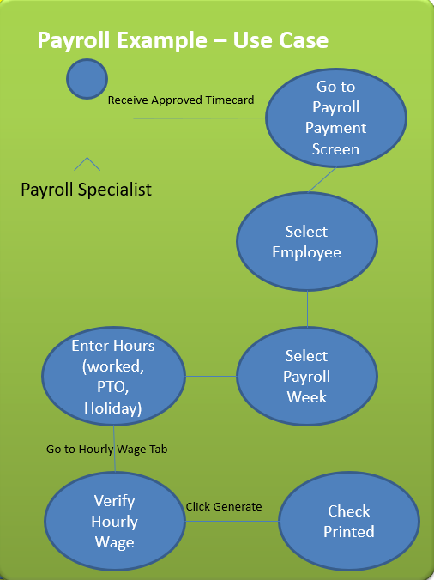
Dependent processes (approval process)
Alternative and negative scenarios (unapproved, pending)
Identify other roles
Identify security profiles
Test Data that covers all scenarios
Triggers or constraints
Boundaries, break or threshold criteria
Manual processing steps
Detail expected results
Negative results (ie. Generating a check on non-payroll dates)

Slide 9
The definition and Format of acceptance criteria
Agreed upon criteria that, when present, confirms any piece of work is “done” and working as the user intended.
Given <a scenario, persona or test preconditions>
and/or When <action is taken, test steps>
and/or Then <purpose, expect this outcome, test expected result>
and
Notes:
For a backend or technical story, the given could be what data setup is needed, what state does the system need to be in.

Slide 10
acceptance criteria checklist
Have clear pass/fail results
Focused on the end result/functionality
Include non-functional requirements (usability, maintainability, scalability, reliability, extensibility, security, portability, accessibility)
They can build on each other. A Then from one can become the Given for another.
When the THEN changes, typically indicates a new/another acceptance criteria is needed.
THEN statements should not have Ors, that too indicates a new/another acceptance criteria is needed.
Stories will typically have more than one acceptance criteria. There is no need to try to cram all the information into a single acceptance criteria.
Each story should relate to a single functionality and meet the Definition of Done
Acceptance criteria should meet the INVEST and 5-C’s criteria

Slide 11
Benefits of well written acceptance criteria
Written in a simple language – easy to understand for all readers and can result in better feedback
Focuses on how a feature or piece of functionality will work from the user’s perspective
Remove ambiguity from requirements enabling agreement across all team members and stakeholders
Form tests that confirm when a feature or functionality is working and done
Improve quality earlier in the lifecycle
Helps focus on how to break it including alternate and negative paths
Can more easily be automated since it the test data required, execution steps and expected results are defined
The GIVEN WHEN THEN format enforces a structure that facilitates clarity by imposing contextual information on state/situation and resulting state.

Slide 12
The 5 C’s PLUS: Evaluating testability for Acceptance criteria
Atomic (Small)
Uniquely Identified (Non-Compound)
Complete
Consistent
Correct and Clear (Unambiguous)
Prioritized
Traceable
Notes:
Source: On-Track Requirements: How to evaluate requirements for testability (Free Template)
User Story Testability Scorecard (Free Template)

Slide 13
To do’s During refinement
Scorecard the acceptance criteria based on the 5 C’s
Identify any vague or unclear statements, terminology, acronyms. Ensure they are recaptured with more precise wording or terms.
Ensure the acceptance criteria is measurable and quantitative
Ensure the User Story and acceptance criteria do not contain qualifiers
A lot
Many
Better
Easier
Etc.
Enough time is spent time reviewing and refining the acceptance criteria.

Slide 14
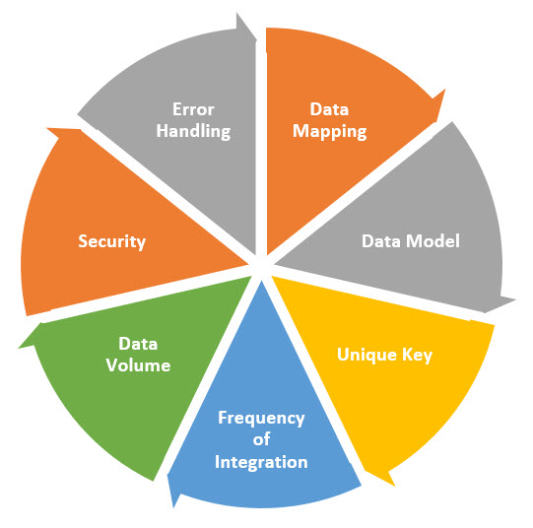
Topics to ensure to cover during refinement

Slide 15
Example Questions to ask during refinement
Who else will use or consume this functionality?
What other types of users should be considered?
What kind of access or profiles will be required?
Do the profiles or access need to be updated?
What information can this user/role see?
Does any automation or custom component use this?
Is the pass/fail criteria clear?
What are the alternative and exception scenarios?
Page layout (order, visibility, related lists, editability)
Object compact layout
Does the new object render on other pages?
Where do we create technical debt if we implement this user story as planned?
What vague terms are used in the user story—e.g., fast, soon, early, better, easy?
Can we split the user story into smaller ones and still add value?
What error handling is needed?

Slide 16
Example Non-Functional Requirement questions
Usability:
Are the most common operations streamlined to be performed quickly?
Can new users quickly adapt to the software without help? (is it intuitive?)
Do validation and error messages make sense?
Maintainability/Flexibility/Testability
Does the entire team understand the code base or does knowledge islands exist?
Is the code thoroughly regression tested?
Can modifications to the project be done in a timely manner?
Scalability:
What is your current peak load that you can handle?
How many database records can create until critical operations slow down?
Is the primary scaling strategy to “scale up” or to “scale out” — that is, to upgrade the nodes in a fixed topology, or to add nodes?
Availability/Reliability
How long does the system need to run without failure?
What is the acceptable length of time for the system to be down?
Can down times be scheduled?

Slide 17
Example Non-Functional Requirement questions
Extensibility:
Can the database schema flex to accommodate change?
Does the system allow Inversion of Control (IoC)?
Can end users extend the system (scripts, user defined fields, etc.)?
Can 3rd party developers leverage your system?
Security
Does the system need user or role based security?
Does code access security need to occur?
What operations need to be secured?
How will users be administered?
Portability:
Can the data be migrated to other systems?
For web applications, which browsers does your web app support?
Which operating systems does your program run on?
Accessibility
What disabilities do we need to consider? Some examples include visual impairment, color blindness, impaired hearing, dyslexia, dementia, autism, loss of limbs, mobility issues and the list goes on.
Is the functionality Perceivable, Understandable, Operable and Robust?
Notes:
The user must be able to perceive the information they need, that means it should be available to one of their senses be it sight, hearing or touch. You should not isolate one group from accessing information available to another, for example if information is displayed as text then a screen reader should be able to convert it to speech.
understandable, we must consider those who struggle to process text, let’s take dyslexia as an example. We should keep copy brief and to the point and avoid alienating language and using large bodies of text which could be overwhelming for the user.
It must be operable, if someone is using a keyboard or even no keyboard for example, they can still do everything that someone using a mouse can do. This includes being able to navigate the website, use forms to provide information and use controls such as buttons. The service should also be robust so that technology being utilised by a user works as it should every time, such as a screen reader.

Slide 18
Check us out at www.savvyquAlity.com
Free Templates (including two supporting this session):
Testable Requirements Scorecard – score your user stories and acceptance criteria for testability
Testable Requirements Article – On-Track Requirements: How to evaluate requirements for testability by Rodger D. Drabick, CQA, CSTE
Many other Planning, Design, Status Reporting, Project Closeout templates – ALL FREE!
First 20 email requests will get a FREE copy of my Book “Quality Assurance 101: Best Practices Made Easy”
Email rachelle.m.rood@gmail.com with shipping information. First 20 emailers will get a free copy.
An Amazon review once you’ve read it is always appreciated. It helps readers find our content!

Slide 19
Questions and answers
This Photo by Unknown Author is licensed under CC BY-NC

Slide 20
Thank You
Savvyquality.com
Rachelle.m.rood@gmail.com

Slide 21
Appendix B
https://www.youtube.com/watch?v=IYw7FqsY_RA
http://codesqueeze.com/the-7-software-ilities-you-need-to-know/
https://www.modernanalyst.com/Resources/Articles/tabid/115/ID/5451/Requirements-Gathering-meets-Accessibility-Needs.aspx
https://agilephilosophy.com/2015/04/17/the-life-of-a-user-story/
https://www.pluralsight.com/guides/ensuring-requirements-are-testable-in-agile
https://corebts.com/blog/how-to-identify-good-bad-agile-user-stories/
https://agilevelocity.com/evolution-of-a-user-story/
https://uxdesign.cc/the-story-of-user-stories-part-1-e1c8e4995f7f
https://techbeacon.com/app-dev-testing/agile-leaders-guide-writing-user-stories
https://www.youtube.com/watch?v=rh3AUDS_bMA
https://www.codescience.com/blog/2020/the-5-ps-of-a-testable-user-story/
https://www.pluralsight.com/guides/refine-user-stories-and-acceptance-criteria-with-agile
https://www.agilealliance.org/glossary/invest/

