Slide 1
Tricentis Data Integrity
Drive better business outcomes through data you can trust
Notes:
Hello - Introduction

Slide 2

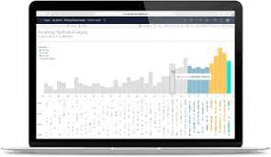
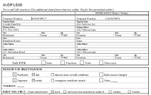




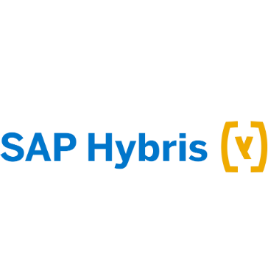
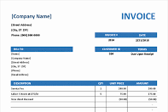

Today, your data is always on the move
through increasingly complex landscapes
Compliance reports
APPLICATION
DATA ANALYTICS / BI
ECOSYSTEM
ECOSYSTEM
ENTERPRISE
DATA LAKE
DATA WAREHOUSE
Business processes
Reports, dashboards, visualizations
…to many different destinations
Notes:
Start with the Problem to be solved
Points to make:
Data is constantly moving through increasingly complex landscapes to various destinations which may be: (click through to bring up the destinations below)
A Tableau dashboard used by the VP of sales
A business process to produce invoices from multiple ERP and accounting systems
Or a compliance report that’s sent to regulators

Slide 3

Your data can break
at any point in its journey
APPLICATION
DATA ANALYTICS / BI
ECOSYSTEM
ECOSYSTEM
ENTERPRISE
DATA LAKE
DATA WAREHOUSE
Reports, dashboards, visualizations
…and finding where it broke is time consuming and expensive
Notes:
Points to make:
As data is moving it’s often transforming along the way and can break at any point in its journey
Describe one data journey where a B2B customer records are created in SAP Hybris and get integrated with their SAP ERP instance. The customer data finds it’s way into an MDM hub along with data from many other sources and everything is still correct, but by the time it gets into a Tableau report used by the VP of sales to track growth, something broke.
Finding where it broke can be a time-consuming, expensive, and frustrating task—draining resources that could be better spent on driving innovation

Slide 4
Costly consequences
Major
oil & gas company
$2.2 million
per month
for your brand and bottom line
Untrustworthy reports, poor decision making, data monetization issues
Notes:
And those errors can have dire consequences for your brand and bottom line.
Example of where bad data caused a poor decision that resulted in a cost of $2.2 million per month.
Major oil and gas company must make decisions on storage capacity based on very large aggregated numbers, the totals while off only 1000th as a percent represented a $2.2 million dollar a month loss under reporting capacity. It is impossible to find these problems in analytics calculations without a true end to end view of the data.

Slide 5
Costly consequences
Top 5 US insurance company
40k
Incorrect invoices
for your brand and bottom line
Untrustworthy reports, poor decision making, data monetization issues
Operational issues across business processes
Notes:
An example of bad data causing costly operational issues:
Top 5 national insurer created over 40,000 incorrect invoices due to data error introduced into the process. Without an automated tool to systematically find data that didn’t match pre-defined tolerances it would have been impossible to quickly pinpoint the root cause of the issue. Once the errors were found, the team at the insurer could take steps to prevent future discrepancies from occurring.

Slide 6
Costly consequences
Major bank
$50M+
In AML/KYC fines
for your brand and bottom line
Untrustworthy reports, poor decision making, data monetization issues
Operational issues across business processes
Costly
compliance issues
Notes:
Compliance reporting issues cost companies millions each year. One of our customers, a Major Global Bank came to us after receiving over $50M+ in AML ( Anti Money Laundering) and KYC (Know Your Customer) fines was able to almost triple the data testing of end-to-end compliance scenarios in a short testing window. They now have time for both regression testing and have real-time monitoring capabilities to reduce the risk of compliance reporting errors.

Slide 7

Costly consequences
for your brand and bottom line
Untrustworthy reports, poor decision making, data monetization issues
Operational issues across business processes
Costly
compliance issues
Major pharma company
$100’s million
In failed innovation
Suboptimal AI/ML-driven initiatives
Notes:
And today with vast investments being made in AI technology, trustworthy data is essential if you’re going to yield an optimal return on that investment. Machine learning algorithms fed with poor-quality data is going to result in poor-quality analytical models and processes.

Slide 8
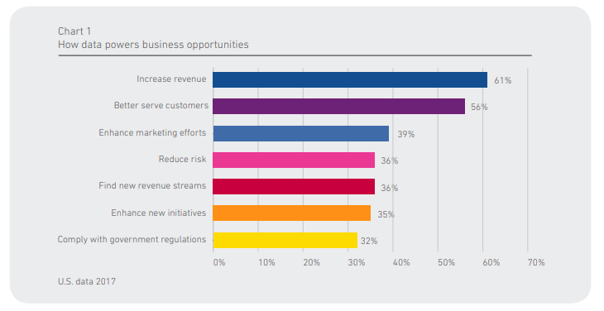
Why is data do Important in General?
Source: Experian

Slide 9
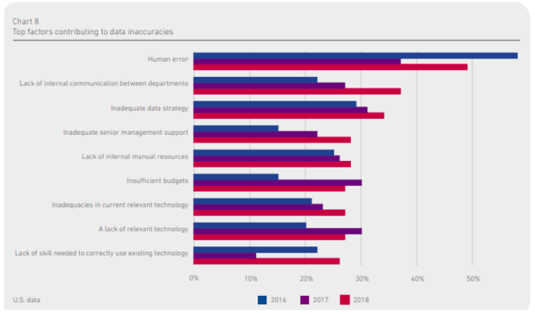
Why Dirty Data?
Source: Experian

Slide 10


Manual “stare and compare” is slow and doesn’t scale.
And is not a great use of your team’s brainpower.
Notes:
Manual Testing of data, manual reconciliation, adhoc checks –> LOW Coverage = High Risk
Cross your fingers and hope for the best, Fail in production, regulators won’t spot it, the customers will look past the errors,…

Slide 11



Point solutions are great…
Information
Steward
Data
Services
DATA ANALYTICS / BI
ECOSYSTEM
ENTERPRISE
DATA LAKE
MDG
DATA WAREHOUSE
Advanced Data
Migration by Syniti
…but leave dangerous data management gaps
Notes:
If you're like most enterprise organizations, you've already invested in lots of tools to get and keep your data in good shape. Fantastic, they do a great job at what they do — keep on using them. The issue is that they're designed with a particular task in mind — like governing your master data or profiling data at specific points in time, like after a transformation event. In complex enterprise landscapes where you're dealing with masses of structured and unstructured data from many different systems, these point solutions leave dangerous data management gaps.

Slide 12
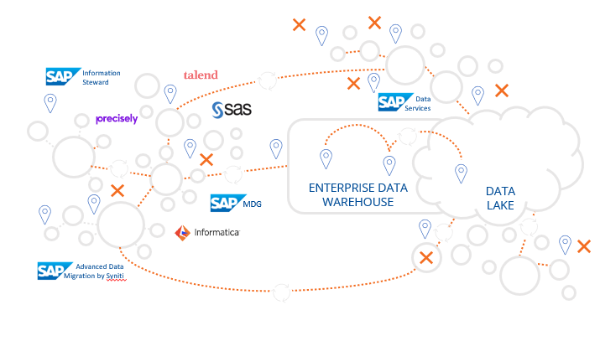
Data Gaps
Data Models
Data Rules & Constraints
Definition and Formats
Aggregations & Transformations
Source Data Standards
Data Variety-Structured, Semi-Structured & Unstructured Data
Data Volume, Velocity, Veracity & Value
Data Location-On Prem, External via public or private cloud- Hybrid, varied, & changing
Applications
Computing Environments

Slide 13
It’s time to bring the discipline
of end-to-end testing
to the world of data
Notes:
We believe that it’s time to bring the discipline of end-to-end testing, familiar in the software space, to the world of data to fill your data management gaps and improve data quality at scale

Slide 14

Includes data, UI, and API testing for any data type — across your
entire landscape.
A data testing solution that’s…
End-to-end
Automated
Continuous
Notes:
Tricentis Data Integrity is a data testing solution that end-to-end, automated, and continuous.
By end-to-end we mean that you can test your data at all points on its complex journeys through your business processes and analytics and reporting use cases. That means being able to test at the data, UI, and API layers and being to test any type of data—from your highly structured data to unstructured big data sources.

Slide 15
Major global bank
16x
More anomalies caught
70k tests
in 15 minutes
So, you can…
Catch more data errors up front
Test at high volume and velocity
Get higher data quality at scale
Notes:
In our banking examples
70,000 scenarios to test Our automation allowed to spot many times the anomalies and due to its scallability

Slide 16
Fill your data management gaps
with data testing that’s end-to-end, automated, and continuous
APPLICATION
DATA ANALYTICS / BI
ECOSYSTEM
ECOSYSTEM
ENTERPRISE
DATA LAKE
DATA WAREHOUSE
Notes:
In summary, Tricentis Data Integrity enables you to fill your data management gaps so you can drive higher quality and better business outcomes at scale.

Slide 17


An addition to your toolkit
to maintain data integrity across the enterprise
Point products
End-to-end data testing
Better business outcomes
System/vendor
Type
Time
Data & system agnostic, automated, continuous
Data profiling, data quality, data stewardship, MDM, ETL testing, BI & reporting testing, EDW testing….
Notes:
Points to make:
Existing data tools are great at what they do. We do not replace them, rather we complement them. Some tools are designed to improve data quality for a specific type of data (like master data) or after specific events, like ETL testing tools, or profile data at a certain point in time.
We help protect the investment made in those tools and maintain data integrity wherever data travels by carrying out end-to-end data testing that agnostic of the type of data, or system.
Our testing solution is model-based and automated so you can test at speed and scale and detect more errors upfront.
By combining what we do with existing data tools, you can drive high data quality and better business outcomes at scale

Slide 18



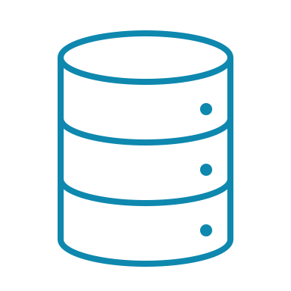
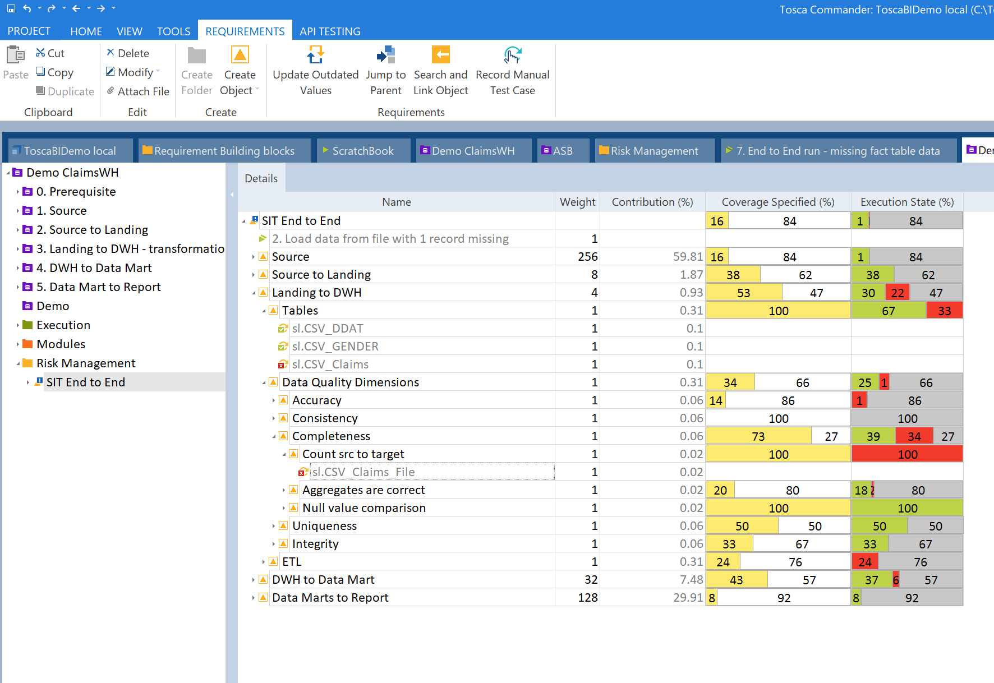

How DI works
to continuously
improve your data
400k+
rows tested in
< minute
RUN
against data at scale and speed.
Get detailed, actionable reports.
Collaborate across teams to
build better tests—end-to-end
CREATE
REPORT
model-based data tests.
Pinpoint
the root cause of problems.
AUTOMATE
QA
Business
Data
No-code, low-code tool
No expert SQL skills required
FIX
Notes:
Points to make:
First, we make it quick and easy to create and maintain tests with our model-based test automation.
People don’t need expert SQL skills to quickly create and maintain tests at scale
Maintenance of test cases is a big deal if you have to hard-code scripts with complex SQL queries
Quick and easy maintenance means that our customers can keep up with a constantly changing landscape
This means that QA, business, and data teams can collaborate to build tests that catch more errors
Next, we have the capacity to run a large volume of tests at high speed
We then are able to produce reports that pinpoint the root cause of problem
This enables companies to fix the issues faster instead of spending weeks or months wasting time trying to track down issues

Slide 19






Data Integrity Business Value of End-to-End Data Test Automation
Eliminate manual testing & system investigation work
Increase data test coverage by 2.5X from Sources to Reporting
Reduce the $15m (avg) in Business Decisioning Mistakes
Minimize regulatory and compliance fines (> $10’s of Millions)
Business Data Operational production failures reduced by 90%

Slide 20
Customer case studies

Slide 21




Customer success
GLOBAL BANK
RETAIL GIANT
BUSINESS DRIVER
Meet more stringent regulatory and compliance requirements.
BUSINESS DRIVER
Maintain data integrity during the migration to Snowflake.
BUSINESS DRIVER
Speed up testing and drive innovation without relaxing quality standards.
BUSINESS DRIVER
Deliver decision-grade data for investment modeling, client reporting, cash flow analysis and more.
RESULTS
Reduced testing cycles from bi-annually or quarterly to bi-weekly.
Increased risk coverage 6X to 90%.
Tests executed in hours versus weeks.
RESULTS
Updates released faster and with increased confidence.
100+ database tables with up to 40M records automatically compared.
6,000 hours of “stare and compare” testing eliminated.
RESULTS
Migration occurred 50% faster while maintaining data integrity.
Ability to test analytical and business processes.
RESULTS
Greatly improved compliance data quality.
70k scenarios tested in 15 mins.
Increased coverage of compliance scenarios by 2.5x with automation and caught 16x more anomalies.
Notes:
Talk to each…

Slide 22
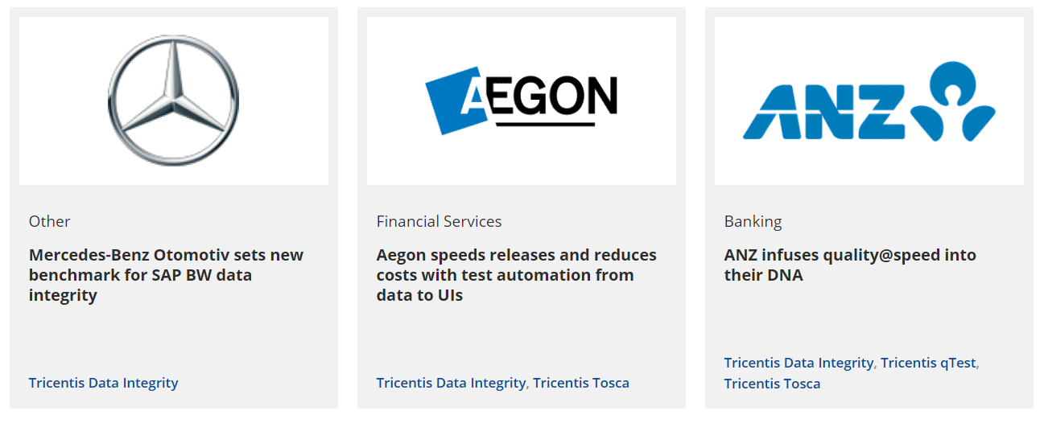
Client Success Stories

Slide 23
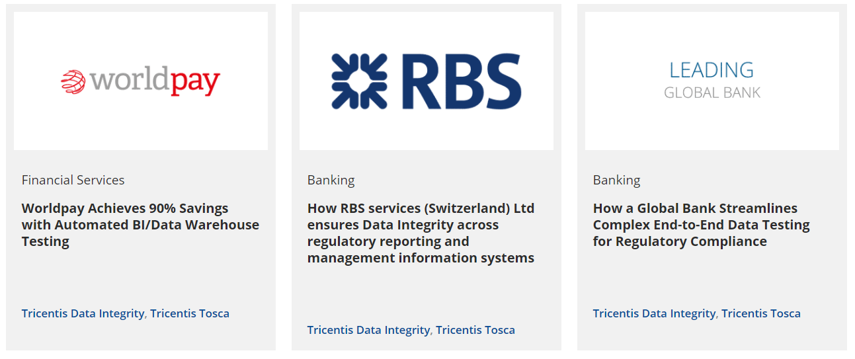
Client Success Stories

Slide 24

Worldpay delivers decision-grade data from 40 billion annual payment transactions across 146 countries
CHALLENGES
Deliver decision-grade data to business teams from massive volumes of transactional payment data.
Handle complex IT landscape that ranged from cloud-based apps to legacy mainframe systems.
Test data from 146 countries, 126 currencies, and 300 payment types.
Achieve goals with no existing tools, people or processes for testing data at scale.
RESULTS
200 million values compared in just 20 minutes.
90% reduction in cost.
90% reduction in testing timeline.
Thousands of hours of manual effort saved per month.
Improved user adoption and productivity as a result of improved data quality.
SOLUTION
End-to-end automated testing across source systems, data warehouse, and reporting platforms.
Notes:
200 million – scale and speed
Cost because of efficiency of automation
IMPROVED ADOPTION

Slide 25
“
A few months after our new BI/data warehouse testing approach launched, people finally started trusting the applications.
They’re highly used now, and they have become a vital tool in making critical business decisions.
Head of Enterprise Quality Assurance Team, Worldpay

Slide 26

About
Mercedes-Benz Sales is responsible for selling Daimler’s range of light commercial and passenger cars.
Mercedes-Benz Otomotiv is their legal entity in Turkey and is also an IT base and solution center delivery for more than 40 countries.
CASE STUDY
Mercedes-Benz drives better customer experiences and higher revenue through better data.
Business drivers
Drive better customer experiences across touchpoints and unlock new revenue potential by creating a centralized place for trusted customer 360 data.
Notes:
Ukl: I’ve updated the “About” section to make it clearer who the business owner of the application is (Mercedes-Benz Sales). Accordingly, I’ve updated the wording below, too.
Mercedes-Benz Sales understood that having a trusted source of customer data was essential for delivering great customer experiences across in-person and digital touchpoints and for giving their direct sales outlets and network of independent dealers the information they needed to drive incremental revenue.
The business and IT teams embarked on an ambitious project to consolidate, normalize, and standardize a myriad of customer data sources and make that trusted data available to the people and systems that needed it. As Mercedes-Benz Otomotiv in Turkey are positioning themselves as the test delivery center in the entire Daimler organization, they have been awarded responsibility for testing this new application.

Slide 27
Project IDA—Integrated Data Architecture
Complex transformation rules
Large data volumes
Frequent changes expected with source systems and new requirements to the IDA solution
Lack of resources with advanced SQL and SAP BW skills
Challenges
Initial manual test plan could not:
Provide end-to-end coverage
Handle volume
Keep up with changing environment
Notes:
Ukl: Slightly updated the project description – note that the technology landscape is not all that complex, it’s more the business rules and the heterogeneity of the data structures that lead to challenges

Slide 28





End-to-end data testing
for higher data quality at scale
Provide access to trustworthy customer 360 data:
Dealers and internal teams via web portal
Systems via data feeds
Solution
Ingest customer master and transactional data from dealer, internal, and external systems.
Consolidate into EDW.
Transform into data marts.
EVENT
ISSUES FLAGGED
Data transformation
ISSUE FLAGGED
ISSUE FLAGGED
Customer names being cut off due to data type mismatches
API calls using fuzzy logic return wrong customers
Incorrect vehicle history for customers
Wrong revenue numbers for certain customers
Notes:
The issues listed in the “Issues flagged” are the most prominent and easy to understand ones, other identified issues include wrongly assigned phone numbers and invalid vehicle attributes

Slide 29

Solution metrics
1
test type
Billions
of rows
tested
400k+
rows tested in < minute
25
flexible test cases
Solution
250+
variations
Solution
It’s impossible for humans to test billions of rows of data. We can now test nearly half a million rows in just one minute. There’s just no comparison.
Ezgi Çetin, Test Automation Engineer, Mercedes-Benz Otomotiv
Notes:
Ukl: To me circles 1 and 2 are easy to understand; the story for circle 3 should be “it’s a complex application with complex business rules, but testing it with Tosca DI / EDIT is easy and straight forward, one doesn’t need to study the test automation tool for ages to being able to test this kind of application”

Slide 30



Business results
220
Testing days saved
Results
Errors pinpointed for faster fixes
The testing authority
Higher quality customer data
at speed and scale
Notes:
Saved 220 business days of labor for testing this single application
Additionally saved significant development effort by providing error details rather than just success / failure
Helped the Service Delivery Center of Mercedes-Benz Otomotiv to position themselves as THE testing authority for data centric applications leading to additional opportunities both for them and for Tricentis
Ukl: Savings in terms of days of labor will grow exponentially when expanding the approach to other applications in the data space; for the development effort it’s important to understand that if you have hundreds of tables to test, each containing 20+ columns you need to know which column and which data constellation is exactly affected by a deviation between actual and expected result; the 3rd item is rather soft, but nonetheless important in large organizations like Daimler

Slide 31

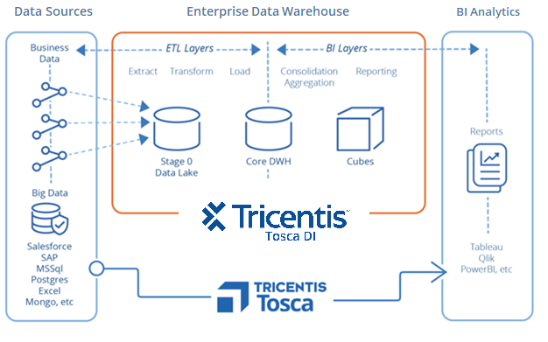
Automated Data Integrity
Only solution in the market for Automation and End to End Testing across the EDW
Move from Manual SQL Scripting to Scriptless Model Based Test Automation
Covers all Reconciliation and Validation Tasks across the EDW from Sources to Stores to Reporting and Visualizations
Wizards for Ease of Use by any BA, Data Steward, DA, Data Engineer and others
Eliminates Manual Testing of High Impact Data Use Cases such as PDFs, Structured, Unstructured, and Message Data
Notes:
Tosca BI:
* Tosca BI includes Tosca (Commander)
* EDW – Enterprise Data Warehouse
* - BA – Business Analyst
* - DA – Data Architect
* - Data Lake – Data Store usually cloud based ie. Hadoop
* - DWH - Data Warehouse - Where the ETL's run - (Extract Transform Loads) usually more traditional data store like Teradata and Informatica for ETL processes
The Main Points:
Automation and End to End:
data validation and reconciliation across the entire data process ANY and ALL Sources to Data Ingestion to the Data Lake into Data Warehouse (DWH) to the Data Marts to Analysis and Reporting / Visualizations. We are the ONLY solution that has Automation and End to End capabilities
High Impact use Cases:
Tableau Reconciliations - One report at a major gas and oil integrator was off by 1,000% of a percent but since it was aggregated data you couldn't see it in the reporting and analytics by eyeballing it, you had to test the entire process from sources through ETL to the end Tableau, then we fixed the $2M dollar a month issue! - You have to have End to End to do this!
Easy to Use:
THE CHALLENGE is SOURCE DATA - 60% of the data entering is unstructured,, message and some structured data, we are the ONLY solution that can test against ALL these SOURCES including Application data - Salesforce and SAP). Data Stewards who are usually not SQL experts can use Tosca BI to ensure data integrity is good feeding your data process FROM THE START!

Slide 32

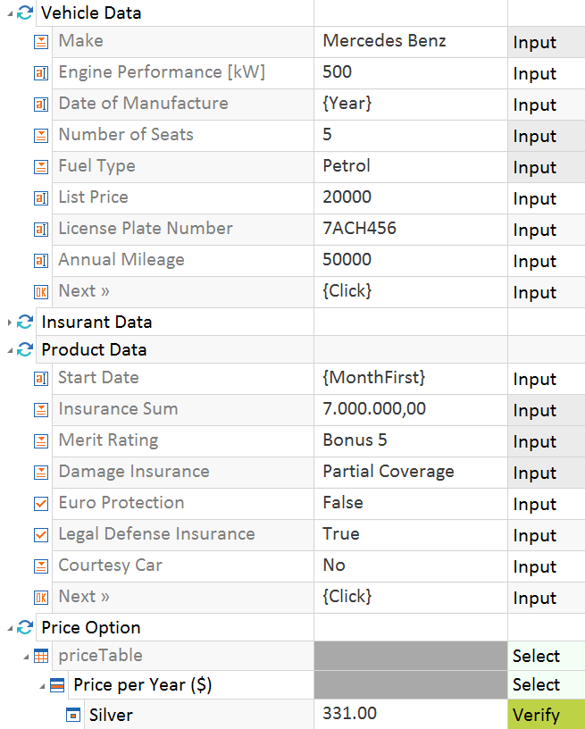
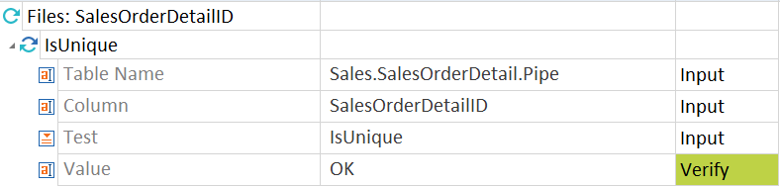
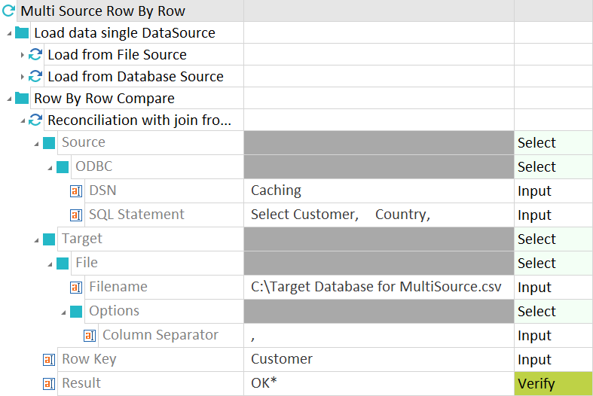

Model Based Data Integrity
Tosca
SQL Script-Based
Easy to create/read
SELECT cust_city_id, ((new_cust_sales - old_cust_sales)
/ old_cust_sales ) pct_change, old_cust_sales
FROM (
SELECT cust_city_id, new_cust_sales, old_cust_sales
FROM ( --START: Cities AND sales for 1 country in 2 periods SELECT cust_city_id,
SUM(CASE WHEN t.calendar_quarter_id = 1776
THEN amount_sold ELSE 0 END ) new_cust_sales,
SUM(CASE WHEN t.calendar_quarter_id = 1772
THEN amount_sold ELSE 0 END) old_cust_sales
FROM sales s, customers c, channels ch,
products p, times t
WHERE s.prod_id = p.prod_id AND p.prod_total_id = 1 AND
s.channel_id = ch.channel_id AND ch.channel_total_id = 1 AND s.cust_id = c.cust_id AND c.country_id = 52790 AND
s.promo_id = 999 AND
s.time_id = t.time_id AND
(t.calendar_quarter_id = 1776 OR ) GROUP BY s.prod_id
) prod_sales --END: All products sales for city subset
WHERE cume_dist_prod > 0.8 --END: Top 20% products)
--START: Main query bloc
SELECT prod_id, ( (new_subset_sales/new_tot_sales)
- (old_subset_sales/old_tot_sales)
) *100 share_changes
= 1776 AND s.channel_id = ch.channel_id
Easy to maintain
Hard to read/create
Difficult to maintain
Notes:
No coding requires less technical skills. Now your manual testers can become automation engineers.
Spend more time executing test cases than maintaining and creating scripts.
Models are resilient and easily updated with rescan.
Achieve 90% test automation.

Slide 33
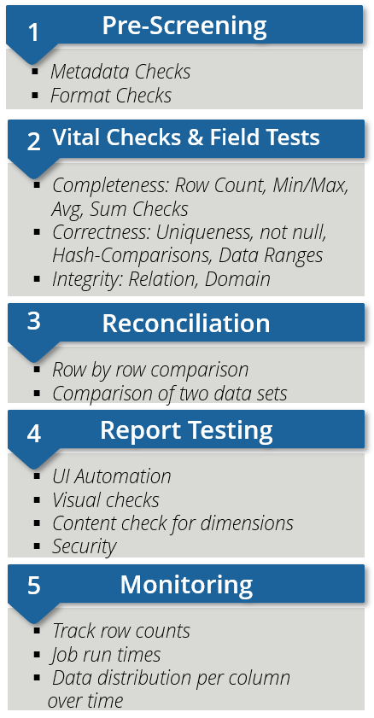




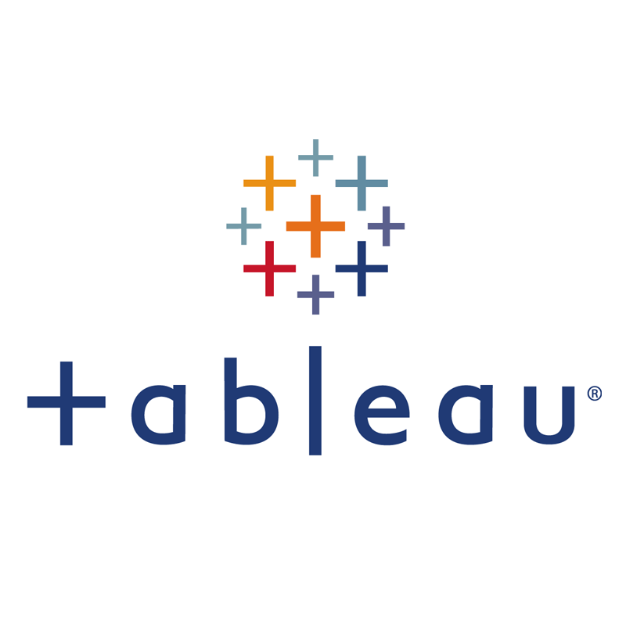

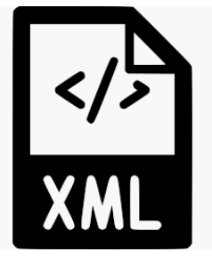








Tricentis Tosca Data Integrity
1
Data Migration
5
4
Extract
Flat Files
Publish
Reports
2
3
Data Warehouse
Business Apps
Test across all layers
Notes:
Our presentations for Snowflake is based on public Medicare data, we have created this simulated data warehouse environment and simulated ETLs so we can automate data tests at specific points.
We start off with a number of flat flies in csv and json format, before we import the data we check that the files metadata and formatting is correct. We will also import our Salesforce data with contact information from the hospitals.
Next, we check the data imported into SQL Server from the staging to warehouse at the Table level. We will then check the data imported into Snowflake at the Field level to showcase one of our Snowflake abilities.
We then check the actual data in Snowflake to ensure it is complete and correctly loaded and transformed using row by row comparisons.
Lastly, we can generate and test BI reports on the selected data using Tableau.
Jonathan can you please show how this all works!

Slide 34





End to End EDW/BI Testing
Pre-Screening
1
Metadata Checks
Format Checks
Data Integration
Data Warehousing
Business Intel
Shared Solutions
4
Vital Checks & Field Tests
2
5
Completeness: Row Count, Min/Max, Avg, Sum Checks
Correctness: Uniqueness, not null, Hash-Comparisons, Data Ranges
Integrity: Relation, Domain
1
2
3
2
Data
Sources
Data Ingestion
Data Storage
Business
View
Reporting & Analytics
3
Reconciliation
3NF
3
E
E
E
E
E
Marts &
Methods
Row by row comparison
Comparison of two data sets
ETL
Bulk
CDC
EAI
Stream
Manual Upload
Data Feder-ation
Data
Vault
ETL
Business
Vault
BRE
DQ
Checks
Views
DB’s -DB2, Oracle, ...
RDBMS
SAP
Hadoop
XLS/CSV
ERP
XML
JSON
API
UI
Parquet,
Flat(fixed and Variable)
Binary(MF)
UIF…
Report Testing
4
L
Star
Schema
IBM
Cognos
SAP BO
MS
SAS BI
MSTR
Tableau
Qlik
Yellowfin
Oracle
Micro-strategy
Power BI
...
4
H
H
D
D
Aggr.
S
S
S
S
D
F
D
UI Automation
Visual checks
Content check for dimensions
Security
ODS
D
D
A
B
C
OLAP
D
E
F
Calculation Engines
DB’s
DB2.
Oracle, …
Monitoring
Exports
5
Hadoop
S3
…
Track row counts
Job run times
Data distribution per column over time
Data Lake

Slide 35
Data Integrity Demo

Slide 36





Product summary
Drive higher data quality at scale with a unique set of capabilities
Data, API, and UI layers
Unique model-based test automation
Test
end-to-end
Test at speed and scale
Test any type of data
Create & maintain tests without coding
Run tailored data tests
Test across the enterprise
Pinpoint root
cause of errors
Manage risk

Slide 37




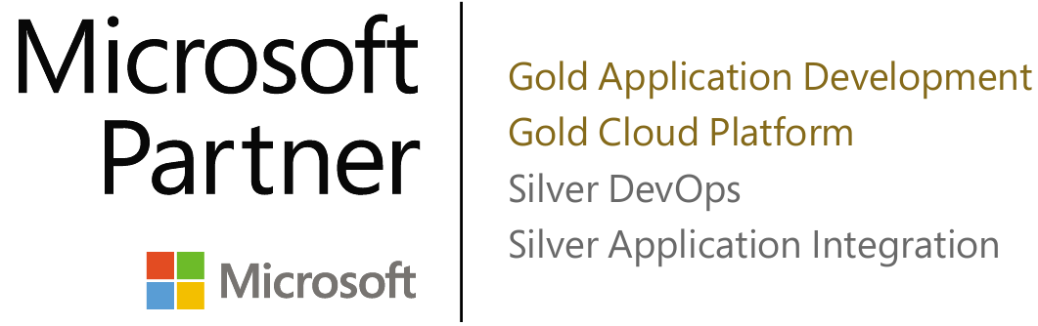





We are Tricentis.
The global leader in Continuous Test Automation
2,100+
customers
200,000+
certified
Named leader in industry analyst vendor ratings
Installed base
world-wide
Tricentis test
automation engineers
Strategic Alliances & Partnerships
Notes:
If you have not heard of Tricentis before, we're the global leader in test automation.
We're recognized by all the major industry analysts as a market leader in the test automation category
Our products and technology is being used by more than 2,100+ customers worldwide.
And there are over 200,000 certified automation specialists that using Tricentis products day in and day out.
We're also very proud of our strategic partnerships and alliances with the major cloud providers, AWS and Azure, and the largest software vendors, SAP, Oracle, ServiceNow and many others. In fact, SAP has selected Tricentis as the recommended vendor for test automation, replacing MicroFocus which they had partnered with previously.

Slide 38

Make better decisions
Get more
reliable processes
Be more compliant
Optimize AI/ML initiatives
Drive data monetization revenue
Drive better business outcomes through data you can trust
Drive better experiences for customers and all stakeholders, sooner
Increase market share and revenue
Reduce risk and costs
Notes:
Points to make:
And at the end of the day, all of this great technology enables you to do what matters the most—and that’s achieve these important business goals (first row of points) by providing more trustworthy data
Achieve those goals and your organization can drive better business experiences for your customers, partners, and other stakeholders faster than ever and make a real impact on both the top and bottom line.

