Slide 1
Testing for Privacy and Data Protection at Speed:
Integrating AppSec Tools into DevOps Pipelines Without Slowing Down
Joe Jarzombek, CSSLP, PMP
Director, Government & Critical Infrastructure Programs
Meera Rao
Senior Director, Product Management (DevOps Solutions)
19 May 2021
Notes:
With the USAF under increasing pressure to deliver software faster, development and security teams have been tasked to devise a strategy to satisfy demands for more secure software and more rapid application development. Joe Jarzombek (USAF Lt. Col., retired) discusses how to address the growing need for both security and speed in application development. He will cover:
Building security into your DevOps SDLC
Integrating the right tools in the DevOps pipeline
Coordinating with various teams to ensure success

Slide 2
Objectives
Testing for privacy and data protection can be a normal part of quality assurance test regimes.
Intelligent orchestration can better enable security testing as part of quality assurance programs.
In this webinar, you’ll learn:
How common weaknesses in software can represent source vectors for unauthorized access to read or modify data; putting enterprises and their customers at risk in terms of data loss or data corruption.
How quality assurance application testing can incorporate tools with built-in security domain checkers/gates to enable all developers and testers to mitigate relevant software weaknesses to address privacy and data protection.
How legacy CI/CD approaches can’t keep up with the speed of DevOps
How Intelligent Orchestration helps break down silos and leverages a dedicated pipeline that automatically runs the right security tools at the right time and triggers manual testing activities based on SDLC events and pre-defined policies, while also providing continuous metrics and feedback.
How this enables quality/security teams to automate security gates and enforce policies for all applications across their organization, at enterprise scale.

Slide 3
Joe Jarzombek, CSSLP, PMP
Director for Government & Critical Infrastructure Programs, Synopsys, Inc.
Member of CWE/CAPEC Board
Member of Governing Board, Consortium for Information and Software Quality
Previously
Global Manager, Software Supply Chain Solutions, Synopsys Software Integrity Group
Director, Software and Supply Chain Assurance U.S. Department of Homeland Security
Deputy Director, Information Assurance (Software Assurance) OCIO, U.S. Department of Defense,
USAF LtCol (Retired)
Joe.Jarzombek@synopsys.com
+1 (703) 627-4644
https://www.synopsys.com/solutions/aerospace-defense.html
https://www.synopsys.com/software-integrity/solutions/government.html

Slide 4
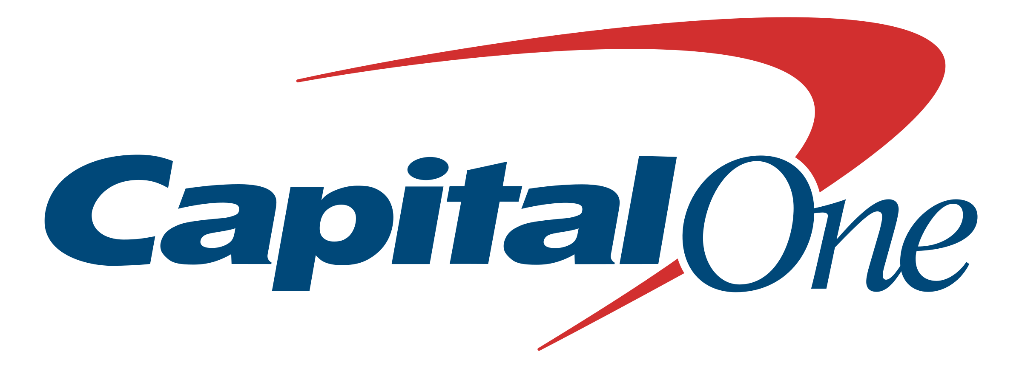
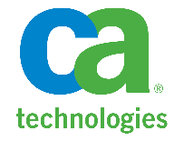
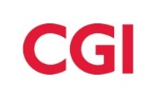
Sponsors, Members and Partners
Joe Jarzombek, CSSLP Governing Board Member, CISQ
Director, Government & Critical Infrastructure Programs, Synopsys
Joe.Jarzombek@synopsys.com
Over 3,000 individual members from large SW-intensive organizations:
Co-founders:
Sponsors:
Notes:
CISQ was formed in 2010 when both the Software Engineering Institute at Carnegie Mellon University and OMG were approached by system integrators and asked to develop standards for measuring software attributes such as reliability and security. These attributes were appearing in development and outsourcing contracts as the equivalent of service level agreements, and every customer had a different definition of how they were to be measured. SEI and OMG co-founded CISQ and asked Dr. Bill Curtis who had led development of the original Capability Maturity Model or CMM to head the consortium. Twenty-four companies including both customers and vendors joined to create the first round of measurement standards. CISQ has evolved to OMG’s traditional model of a special interest group with several companies sponsoring CISQ’s activities. Current sponsors are Northrop Grumman, Cognizant, Tech Mahindra, Synopsys, and CAST. Under this structure, membership in CISQ is free for individuals.

Slide 5
Testing for Privacy and Data Protection in Software
for CMMC, GDPR, CCPA/CPRA, HIPAA/HITECH, and GLBA
Joe Jarzombek, Governing Board Member, CISQ Director for Government and Critical Infrastructure Programs, Synopsys, Inc.
Software Supply Chain Integrity
Notes:
The OMG CISQ Automated Source Code Data Protection Measure specification covers common weaknesses (CWEs) that affect the protection of controlled or confidential information and data associated with intellectual property and privacy, such as associated with personal identifiable information (PII), personal health information (PHI), or payment card industry (PCI) data. Specifying this measure is important as a source of evidence for complying with laws and regulations such as in Europe the General Data Protection Regulation (GDPR), and in the United States the Cybersecurity Maturity Model Certification (CMMC), the California Consumer Privacy Act enhanced by the California Privacy Rights Act (CPRA), the Health Insurance Portability and Accountability Act (HIPAA) enhanced with the Health Information Technology for Economic and Clinical Health (HITECH) Act, and the Gramm-Leach-Bliley Act (GLBA) for financial services.
This measure is calculated from detecting and counting 89 violations of good architectural and coding practices (weaknesses) in the source code that could result in unacceptable risks to the exposure, modification, or theft of confidential information. This measure will supplement ISO/IEC 25023 that provides measures of software product confidentiality (a subcharacteristic of Security) by providing a measure at the source code level for protecting confidential data.
Note: This Automated Source Code Data Protection Measure specification is derived from the Automated Source Code Security Measure specified in the Automated Source Code Quality Measure (ASCQM) specification (https://www.omg.org/spec/ASCQM/1.0/)

Slide 6
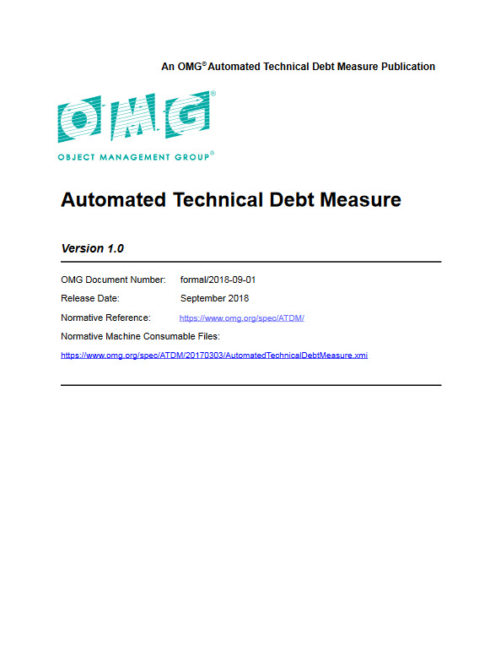
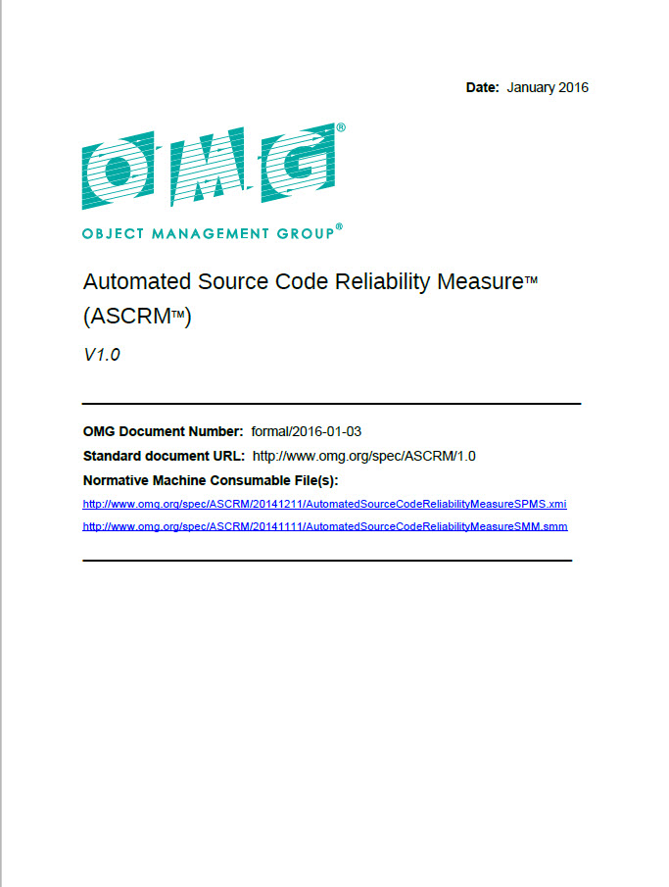
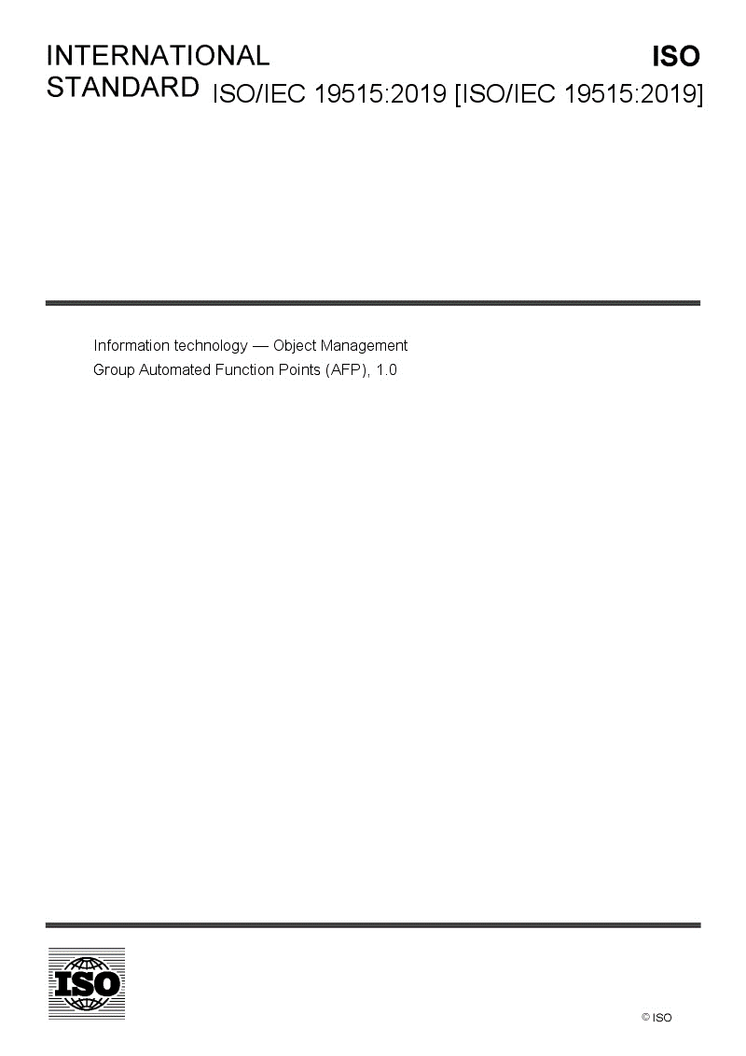
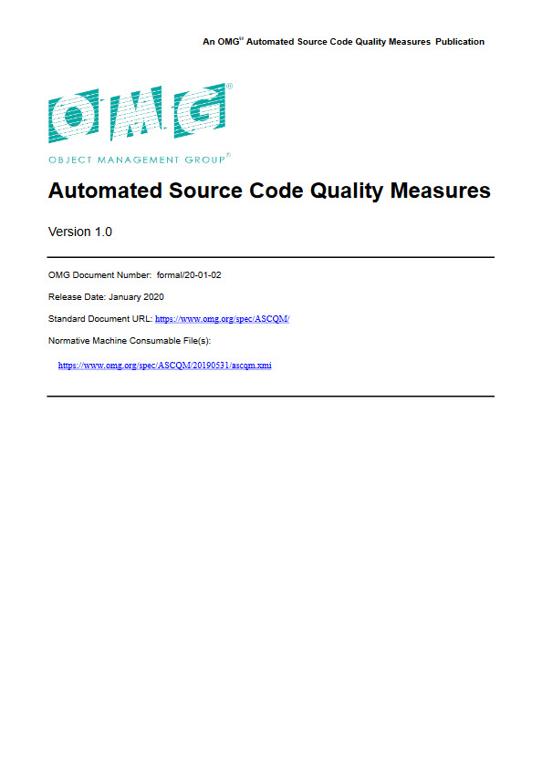
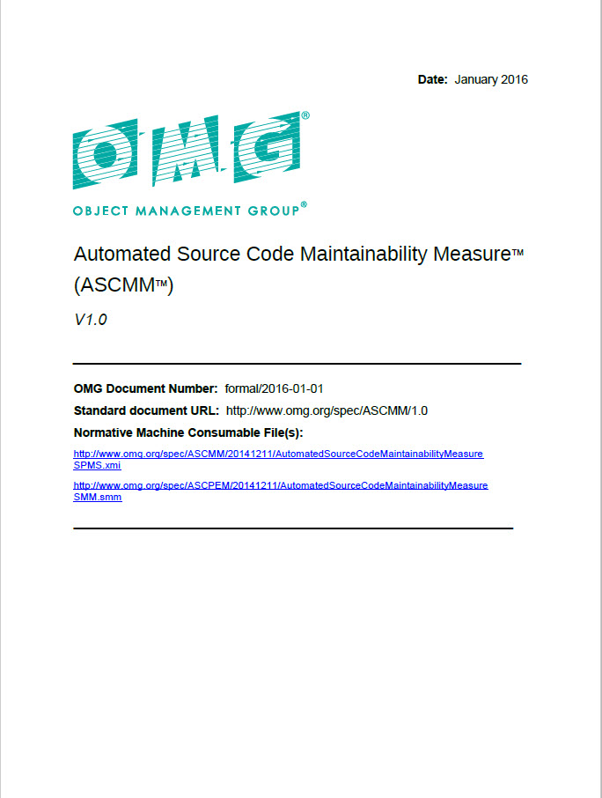
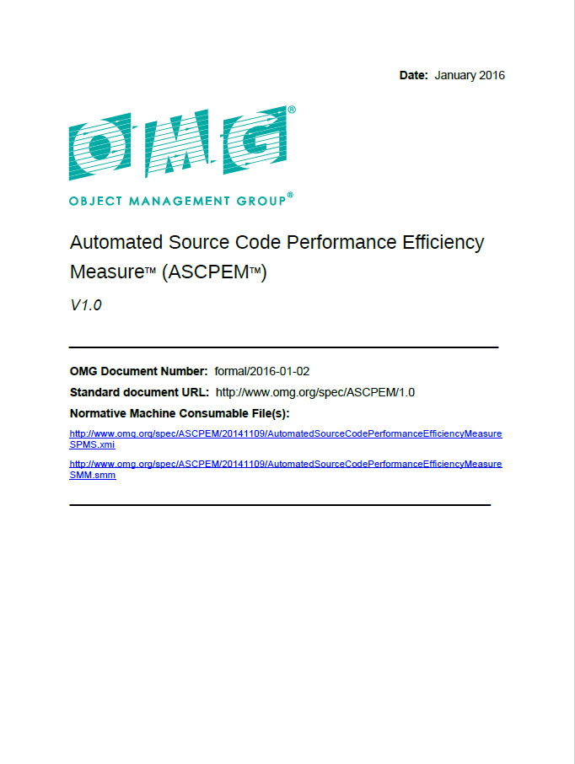
CISQ/OMG Standards & ISO/IEC Fast-track
Object Management Group
ISO/IEC
CISQ was chartered to specify measures of software size and quality that can be automated from source code, and promote those measures through OMG and other international standards organizations
Automated Source Code Quality Measures are 100% based on CWEs at code level; detectable by AppSec tools
To access and acquire a free copy of ISO/IEC 5055 on Automated Source Code Quality Measures, go to https://standards.iso.org/ittf/PubliclyAvailableStandards/index.html
Technical Debt Measure
Reliability Measure
Security Measure
ISO/IEC 5055:2021
Automated Source Code Quality Measures
Software Quality
Automated Source Code Quality Measures
Data Protection Measure
Performance Efficiency Measure
Maintainability Measure
Released April 2021

Slide 7
Exploits, weaknesses, vulnerabilities and exposures
The existence of an exploit designed to take advantage of a weakness (or multiple weaknesses) and achieve a negative technical impact is what makes a weakness a vulnerability.
Weakness: mistake or flaw condition in ICT/IoT architecture, design, code, or process that, if left unaddressed, could under the proper conditions contribute to a cyber-enabled capability being vulnerable to exploitation; represents potential source vectors for zero-day exploits—Common Weakness Enumeration (CWE)
Vulnerability: mistake in software that can be directly used by a hacker to gain access to a system or network
Exposure: configuration issue or a mistake in logic that allows unauthorized access or exploitation—Common Vulnerabilities and Exposures (CVE)
Exploit: action that takes advantage of weakness(es) to achieve a negative technical impact—attack approaches from the set of known exploits are used in the Common Attack Pattern Enumeration and Classification (CAPEC)
WEAKNESSES
EXPLOITS (CAPECs)
VULNERABILITIES
Uncharacterized Weaknesses
Unreported/undiscovered vulnerabilities
CWEs
(characterized, discoverable, possibly exploitable weaknesses with mitigations)
CVEs
(reported, publicly known vulnerabilities and exposures)
Zero-day vulnerabilities
(previously unmitigated weaknesses that are exploited with little or no warning)
Part of the ITU-T CYBEX 1500 series (CVE ITU-T X.1520, CWE ITU-T X.1524, CAPEC ITU-T X.1544) & USG SCAP
Notes:
Weakness: mistake or flaw condition in ICT/IoT architecture, design, code, or process that, if left unaddressed, could under the proper conditions contribute to a cyber-enabled capability being vulnerable to exploitation; represents potential source vectors for zero-day exploits -- Common Weakness Enumeration (CWE) https://cwe.mitre.org/
Vulnerability: mistake in software that can be directly used by a hacker to gain access to a system or network; Exposure: configuration issue of a mistake in logic that allows unauthorized access or exploitation – Common Vulnerability and Exposure (CVE) https://cve.mitre.org/
Exploit: take advantage of a weakness (or multiple weaknesses) to achieve a negative technical impact -- attack approaches from the set of known exploits are used in the Common Attack Pattern Enumeration and Classification (CAPEC) https://capec.mitre.org
The existence (even if only theoretical) of an exploit designed to take advantage of a weakness (or multiple weaknesses) and achieve a negative technical impact is what makes a weakness a vulnerability.
CVE, CWE, & CAPEC are part of the ITU-T CYBEX 1500 series & USG SCAP
Coverity-generated CVSS Reports reveal vulnerabilities
Tools that reveal exploits should report CAPEC IDs

Slide 8
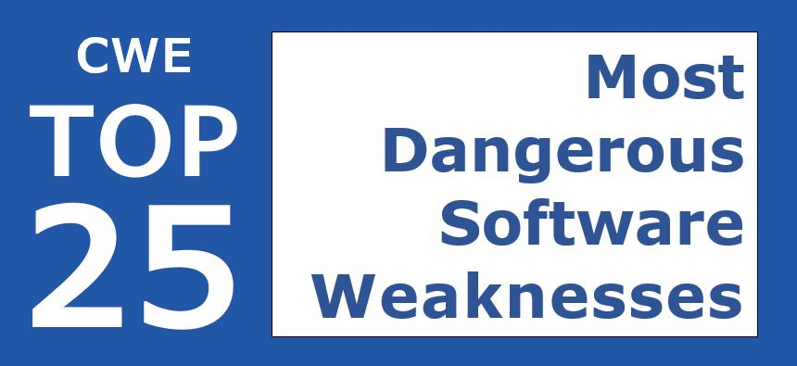
Prioritized CWE lists used by customers
CWE Top 25 — most commonly encountered cyber weakness (CWEs)
OWASP Top 10 —most critical web application security risks – CWEs & CVEs
OWASP Application Security Verification Std v4.0 – 14 categories guide automated unit & integration tests – verification checks with corresponding CWEs
Object Management Group CISQ Automated Source Code Quality Measures for technical debt & structural quality (Performance Efficiency, Maintainability, Security, Reliability, and Data Protection) – all based on CWEs
TOP 10 / ASVS v4.0
Structural Quality Technical Debt
Common Weakness scoring system & risk analysis framework
Common Weakness Scoring System (CWSS)
Common Weakness Risk Analysis Framework (CWRAF)
enable users to create their own custom Top-N lists

Slide 9
Automated Source Code Quality Standards
Security | Measures 74 CWEs in source code representing the most exploited security weaknesses in software including the CWE/Sans Institute Top 25 Most Dangerous Security Errors and OWASP Top 10
Reliability | Measures 74 CWEs in source code impacting the availability, fault tolerance, and recoverability of software
Performance Efficiency | Measures 18 CWEs in source code impacting response time and utilization of processor, memory, and other resources
Maintainability | Measures 29 CWEs in source code impacting the comprehensibility, changeability, testability, and scalability of software
Data Protection | Measures 89 CWEs in source code impacting data leakage or data corruption (potential vectors that could enable unauthorized reading or modification of data)
Use standards as requirements for delivering quality software free from critical weaknesses in code and architecture.
CISQ’s Automated Source Code Data Protection Measure (currently available in the CWE VIEW 1340: CISQ Data Protection Measures) has been added to CISQ’s ASCQM
Standards are available for free download at:
www.omg.org/spec
www.it-cisq.org/standards
Notes:
At a high level, here are the OMG standards now ready for use. CISQ started with automated measures of software sizing, which can be used to measure development productivity or calculate defect densities. CISQ then created structural quality measures. The quality measures are based on quantifying violations of good architectural and coding practice within a software system that can be detected through static analysis. Violations were included in each measure only if they were considered severe enough that they should be eliminated. Technical Debt builds upon the quality measures and is an estimate of corrective maintenance – what it will cost to fix the critical weaknesses remaining in the system’s code and architecture. This is useful when looking at a legacy systems and determining modernization priority and risk. These specifications are operationalized through static analysis. Automation is critical because manual review of software is infeasible for large multi‐layer, multi‐language, multi‐platform systems.

Slide 10
Automated Source Code Data Protection Measure
Supports enterprise and supply chain needs in protecting data, controlled & confidential information, IP, and privacy
ASCDPM submitted in Nov 2020; to become OMG standard, publicly available Dec 2021
Publicly available as VIEW 1340: CISQ Data Protection Measures via MITRE Common Weakness Enumeration (CWE) website
Specifies software weaknesses that enable data leakage/corruption:
CWEs that have CWSS technical impacts that enable unauthorized access to read/modify data
CWEs that are precursors and source vectors for CVEs and zero-day vulnerabilities later associated with data breaches and information loss

Slide 11
Laws and Guidance on Data Protection/Privacy
Organizational process assessments associated with data protection & privacy:
Cybersecurity Maturity Model Certification (CMMC) for CUI → NIST SP 800-171/172
GDPR, CCPA/CPRA, HIPAA/HITECH, & GLBA → NIST SP 800-53 & ISO/IEC 27001
Audit Use-Case for relevance of CWE Data Protection View: Scanning code that will run or is running in enterprise network-connected assets that process or transmit data would determine if the systems or devices enable data leakage or lack adequate protections to mitigate unauthorized access to read or modify data.
If so, then such a scan would reveal if the data protection/privacy controls associated with the process assessment were inadequately implemented.
Using the CISQ Automated Source Code Data Protection Measure (based 100% on CWE) with Software Application Security Testing can provide independent verification of process controls revealing source vectors for data leakage or data corruption:
providing indicators for non-compliance with respective Data Protection guidelines
supporting enterprise and supply chain needs in protecting data, confidential information, IP, and privacy.

Slide 12
Build secure, high-quality software faster

Slide 13
Sampling of Data Protection CWEs
CWE-119 Improper Restriction of Operations within the Bounds of a Memory Buffer
CWE-424 Improper Protection of Alternate Path
CWE-595 Comparison of Object References Instead of Object Contents
CWE- 597 Use of Wrong Operators in String Comparison
CWE-667 Improper Locking
CWE-764 Multiple Locks of a Critical Resource
CWE-820 Missing Synchronization
CWE-131 Incorrect Calculation of Buffer Size
CWE-134 Use of Externally Controlled Format String
CWE-704 Incorrect Type Conversion or Cast
Download full list of CWEs in the chat box
There are also architecture-level issues, not in code-level specification, but listed in informative table

Slide 14
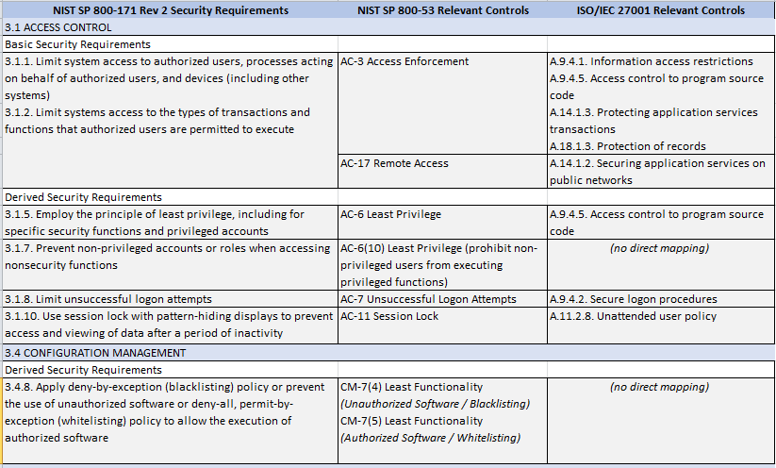
MAPPING SOFTWARE-RELATED DATA PROTECTION CONTROLS in NIST SP 800-171 Rev 2, NIST SP 800-53, and ISO/IEC 27001

Slide 15
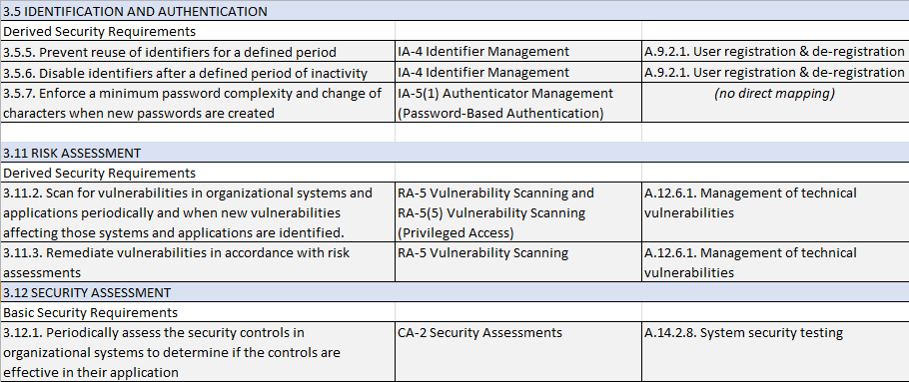
MAPPING SOFTWARE-RELATED DATA PROTECTION CONTROLS in NIST SP 800-171 Rev 2, NIST SP 800-53, and ISO/IEC 27001

Slide 16
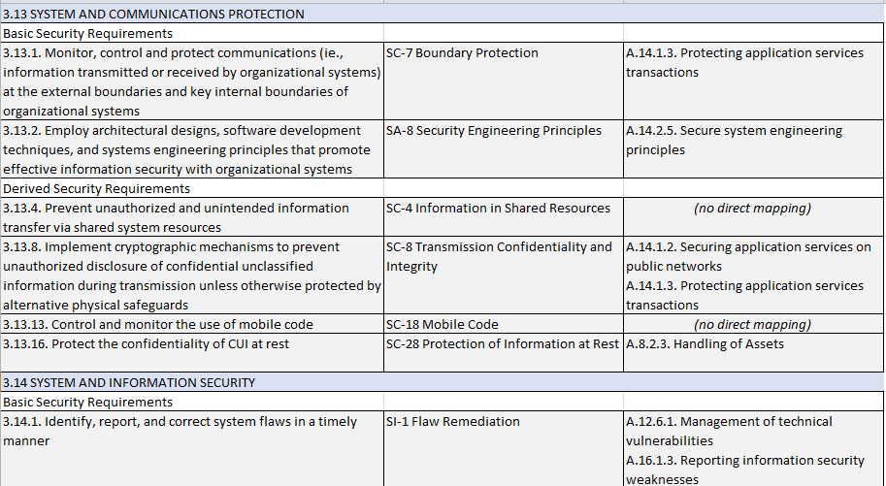
MAPPING SOFTWARE-RELATED DATA PROTECTION CONTROLS in NIST SP 800-171 Rev 2, NIST SP 800-53, and ISO/IEC 27001

Slide 17
Conforms to / Supplements ISO 25000 Series
ISO 25000 series replaces ISO/IEC 9126 (Parts 1-4)
ISO 25010 defines quality characteristics and sub-characteristics
CISQ conforms to ISO 25010 quality characteristic definitions
ISO 25023 defines measures, but not at the source code level
CISQ supplements ISO 25023 with source code level measures
Software Product Quality
Functional Suitability
Reliability
Performance Efficiency
Operability
Security
Compatibility
Maintain-ability
Portability
Functional appropriateness
Accuracy
Compliance
Maturity
Availability
Fault tolerance
Recoverability
Compliance
Time behavior
Resource utilization
Compliance
Appropriateness
Recognizability
Learnability
Ease of use
Attractiveness
Technical Accessibility
Compliance
Confidentiality
Integrity
Non-repudiation
Accountability
Authenticity
Compliance
Co-existence
Interoperability
Compliance
Modularity
Reusability
Analyzability
Changeability
Modification stability
Testability
Compliance
Adaptability
Installability
Replaceability
Compliance

Slide 18
User & Customer Perspectives of CWE
Drive adoption by focusing of why people should care about addressing weaknesses in cyber assets
Exploit potential
Understand the relationship between weaknesses and vulnerabilities
More than patching vulnerabilities
Leverage CWE to enable automation, scalability, and cybersecurity information sharing
Link business & mission risk with weaknesses in cyber assets
Compliance with regulatory statutes, standards and policies
Understand how software assurance can reduce risk exposures

