Slide 1
Unit Testing: Why and How QA Can Get Involved Zenposium 2019 Presented By: David Dang

Slide 2
In this training we will cover:
What is Unit Testing?
Unit Test Benefits
Types of Unit Testing
Three Pillars of Unit and Unit Integration
Levels of Competence in Skills for Unit Testing (QA)

Slide 3
What is Unit Testing?
Unit testing is the smallest testable parts of programmed code (units) that are individually and independently scrutinized for proper operation.

Slide 4
Benefits of Unit Testing
Issues are found at an early stage
At this point, failure is caused by bug in code or possibly with the unit test, so it is easier to trace the failure .
Less costly to find now than later
Working code produced faster and with fewer bugs!

Slide 5
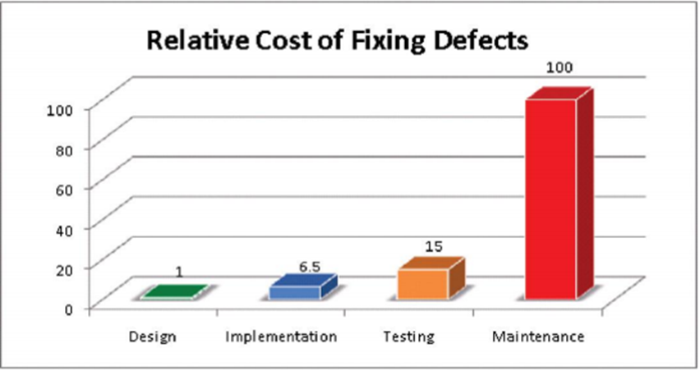
Benefits of Unit Testing
Helps reduce the cost of bug fixes
Defects found in unit test are easier to locate and easier to fix.
Defects found in testing were 15 times more costly than if they were found during the design phase and 2 times more costly than if found during implementation! Source: IBM System Science Institute

Slide 6
Benefits of Unit Testing
Reduces testing overlap between Development and QA
Focus for Unit Testing is on individual function or piece of code, while focus for QA is Functional or Integration testing.
Robust Unit Testing early on will allow QA to focus on Functional testing.

Slide 7
Benefits of Unit Testing
Runs more often (e.g. run during every build)
Can be a low-level regression test suite. You can go back at any time and see not only what broke but where the bug is. Some teams run the unit test suite as part of the nightly build since it is a low effort way to catch bugs before the build goes off to QA

Slide 8
Benefits of Unit Testing
Provides more confidence on code changes
Verifies that the code still works as the code base changes
Makes Integration testing easier, since you have already validated the smaller units
As long as tests continue to pass, you will be sure that code continues to meet requirements

Slide 9
Benefits of Unit Testing
Offered as a form of documentation
Provides “living” documentation of an application. Developers can look at the unit tests to get a better understanding of the code.
Unit tests MUST stay up to date, so unlike requirements documentation, you will always know that you are current. If the unit test happens to become outdated, the unit tests would fail!!!

Slide 10
Benefits of Unit Testing
Covers more combinations & permutations quicker
When Developer has to write unit test, he/she must really think about the design and what needs to be accomplished. Keeps focus and makes for better design.
In order to Unit Test, need to break down the design into the single functions of code. This will improve the overall code design, unit interfaces and the design, itself.

Slide 11
Benefits of Unit Testing
Helps to validate for testability, complexity and reusability
Since Unit is small, test is easier to design, execute, record and analyze test results than larger chunks of code are.
Code becomes more reusable

Slide 12
Two Types of Unit Testing
Unit
Unit Integration

Slide 13
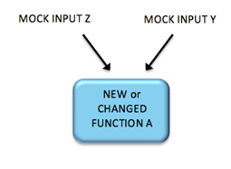
Unit Testing
Tests a single function, class, method, procedure, etc by itself independently of any other programmed code

Slide 14
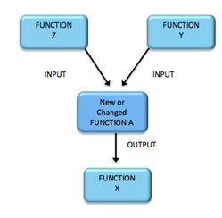
Unit Integration Testing
Tests direct integration with the function, class, method, procedure, etc that is one layer up and one layer down from programmed code

Slide 15
Unit Testing vs. Unit Integration Testing
Unit Integration Testing
New /Changed Code
Unit Integration Testing
Unit Testing

Slide 16
Three Pillars of Unit and Unit Integration
Positive Flow
Negative Flow
Boundary

Slide 17
Positive Flow
Ensure the unit of code works as expected under typical conditions.

Slide 18
Negative Flow
Ensure the unit of code works can handle unexpected events or values. This includes error handling, exception handling, invalid data, etc.

Slide 19
Boundary
Ensure data boundaries are working as expected

Slide 20
Levels of Competence in Skills for Unit Testing (QA)
Comprehending
Defining Scenarios for Development
Authoring
1
2
3

Slide 21
Level 1 -Comprehending
1
At this level tester learns to read unit tests to see what is tested.
Examples:
Learn basic java
Learn JUnit
Should be able to read methods and understand code and unit testing

Slide 22
Level 2 -Defining Scenarios for Development
2
At this level, QA should be able to identify unit testing scenarios for development and then Development will code the unit tests
Should be able to read methods, understand code, find scenarios and create unit testing matrix.

Slide 23
Level 3 -Authoring
3
At this level, QA reads code and can author JUnit tests
QA won’t get to this level right away
Should be able to read methods, understand code, identify unit test scenarios and create Junit tests

Slide 24
Questions

