Slide 1
Continuous Delivery Changes Everything
For the Better!
Zach Beer
Senior Consultant
Polaris Solutions
Notes:
Intro
Originally had a slide deck, decided that wasn’t the best way to go about this
Really easy to say “just do this”, that doesn’t help anyone

Slide 2
Agenda
Introductions
What does continuous delivery do for me?
Doesn’t this kill quality?
How can we get started?
Wrapping up

Slide 3

Why this guy?
Notes:
Ten years working in Chicago-based start-ups
I’ve held nearly every role in a development team
Most of all, though: Because I’ve lived it and know what works.

Slide 4
What brings you here?
"Getting to know you, getting to know all about you.“
― Rodgers and Hammerstein, The King and I
Notes:
Discover audience’s roles (manual QA, automation QA, what else?)
What is your favorite part about your job?
What is your least favorite part?
What do you wish was easier?

Slide 5
What does continuous delivery do for me?
“As soon as Mr. Prosser realized that he was substantially the loser after all, it was as if a weight lifted itself off his shoulders: this was more like the world as he knew it.”
― Douglas Adams, The Hitchhiker’s Guide to the Galaxy
Notes:
Per ZDNet in 2012: $3 trillion in IT failure, worldwide.
Working on IT projects sucks most of the time! What do we always hear?
“Why did we waste our time on this?” -- Team goals that don’t align with company goals
“What do you mean it still isn’t done?” -- Failed projects
“How is this still broken?” -- Quickly and effectively addressing issues
“You guys never get this stuff right.” -- Prevailing attitudes
Gene Kim, author of The Phoenix Project calls this “the downward spiral”
Deadlines get missed, so projects are delivered incomplete
Issues arise in production
Business leaders react poorly
We start padding estimates, acting out of fear
Suddenly, no risk is acceptable because trust is lost.

Slide 6
It enables you to focus on what you love
"Nothing happens without desire and passion. Otherwise, nothing else falls in place. It's very hard to find someone who's successful and dislikes what they do.“
― Malcom Gladwell
Notes:
Business:
Happy customers!
Best possible product!
Maximum revenue!
Minimum cost!
Developers:
More time spent improving technical skills
More time spent on solving real business problems
More time spent on the craft of developing software
QA:
Less tedious bug tracking
Want to make a real difference for users
Operations:
No 2am wake-ups!
Able to solve interesting technical problems like scaling
Able to solve interesting business problems like security and compliance

Slide 7
As soon as something is done, release it
“Play without fear. This is what you’ve been dreaming of your whole lives; go out there and get it. I’ll see you at center ice.”
― Mario Lemieux
Notes:
No long projects, short iterations
Push-button deployments and rollbacks
Automated unit and integration testing
Feature branching and testing

Slide 8
Learn from every release
“If you double the number of experiments you do per year, you’re going to double your inventiveness.”
― Jeff Bezos
Notes:
Learn from every release
A/B testing
Track user engagement
Identify key metrics
Release ideas rather than features
Fake it until you make it
Doesn't have to be fully-featured
Focus on the most important aspects, nail those

Slide 9
Have teams focus on goals, not milestones
“None of us is as smart as all of us.”
― Ken Blanchard
Notes:
Goal: Improve sign-up conversion by 10%
Milestone: Redesign sign-up
Gets everyone involved
OKRs
Guilds

Slide 10
Doesn’t this kill quality?
“The quality of a man's life is in direct proportion to his commitment to excellence, regardless of his chosen field of endeavor.”
― Vince Lombardi
Notes:
Why do we have tightly-constrained releases?
The illusion of control, we can't possibly test everything
Lots of manual steps
No easy or clear rollback plan
Because we're no good at releasing!
How do smaller releases increase control?
Fewer moving pieces, less to test
Lots of practice, rather than doing so rarely
Fewer steps means easier to rollback
What about risk?
Large releases carry lots of risk, since so many pieces move
Not releasing things eliminates risk, but also eliminates added business value
Small releases have risk, but far less since they change little and can be reverted easily
DevOps lives as a symbiotic partner with improving quality and reducing risk
Releasing often requires being able to release quickly and easily
Automating deployment and testing makes this possible
Automated tests can't do everything, but what they can do they do in minutes, not hours
Having quality automated tests frees manual testers to focus on user experience, not technical accuracy
Security
Smaller changes mean less opportunity for new security problems
Automating security checks means it’s verified more often
Ease of update means it’s easier to correct vulnerabilities

Slide 11
A quick tangent: What is “quality”?
External factors:
Does it solve the consumer’s problem?
Does it function properly?
Does it expose the customer or owner to risk?
Does it perform sufficiently?
Internal factors:
Did we do what we intended to?

Slide 12
Doesn’t this kill quality?
“The quality of a man's life is in direct proportion to his commitment to excellence, regardless of his chosen field of endeavor.”
― Vince Lombardi
Notes:
Why do we have tightly-constrained releases?
The illusion of control, we can't possibly test everything
Lots of manual steps
No easy or clear rollback plan
Because we're no good at releasing!
How do smaller releases increase control?
Fewer moving pieces, less to test
Lots of practice, rather than doing so rarely
Fewer steps means easier to rollback
What about risk?
Large releases carry lots of risk, since so many pieces move
Not releasing things eliminates risk, but also eliminates added business value
Small releases have risk, but far less since they change little and can be reverted easily
DevOps lives as a symbiotic partner with improving quality and reducing risk
Releasing often requires being able to release quickly and easily
Automating deployment and testing makes this possible
Automated tests can't do everything, but what they can do they do in minutes, not hours
Having quality automated tests frees manual testers to focus on user experience, not technical accuracy
Security
Smaller changes mean less opportunity for new security problems
Automating security checks means it’s verified more often
Ease of update means it’s easier to correct vulnerabilities

Slide 13
How can we get started?
“Empathy is about standing in someone else's shoes, feeling with his or her heart, seeing with his or her eyes. Not only is empathy hard to outsource and automate, but it makes the world a better place.”
― Daniel H. Pink
Notes:
People fear change
Bring them into the problem solving
Help them understand how the change benefits them
Sneak up on people
Ask questions you know the answers to
Get to know your teammates outside of work
Value their unique views and fears
You cannot dismiss teammates under any circumstance
Primary motivation
Achievement – public (recognition) or private (gold star) rewards
Affiliation – did the team achieve its goal
Power – autonomy
The job will not save you
Just because you're right doesn't mean that's enough
People come around at their own pace
Meet them where they live
Be a flag-bearer
"Because that's how we do it" is never acceptable
Counter the "we don't have time" argument
Just do it
Build quality teams
You may have something you're best at, but it's not your only job
Fight to keep teams together
Fight to keep teams small
Build trust
If you say you're going to do a thing, do it or ensure it gets done
Be honest, even if it makes you look bad
Admit when you make mistakes
Don't punish the well-meaning mistakes of others
Create as much transparency as possible, it gives others the opportunity to shine
Just do it

Slide 14
References
The Phoenix Project
by Gene Kim, Kevin Behr, and George Spafford
Spotify Engineering Culture
https://labs.spotify.com/2014/03/27/spotify-engineering-culture-part-1/
Understand and Build a Continuous Delivery Pipeline
https://www.sumologic.com/devops/understand-build-continuous-delivery-pipeline/
2016 State of DevOps Report
https://puppet.com/resources/whitepaper/2016-state-of-devops-report

Slide 15
How to find me!
Email: zach.beer@polarissolutions.com
LinkedIn: https://www.linkedin.com/in/zlbeer
Slideshare.NET: https://www.slideshare.net/zacharybeer
Twitter: @zacharylbeer
Polaris Solutions website - http://www.polarissolutions.com/
Twitter: @TeamPolaris

Slide 16
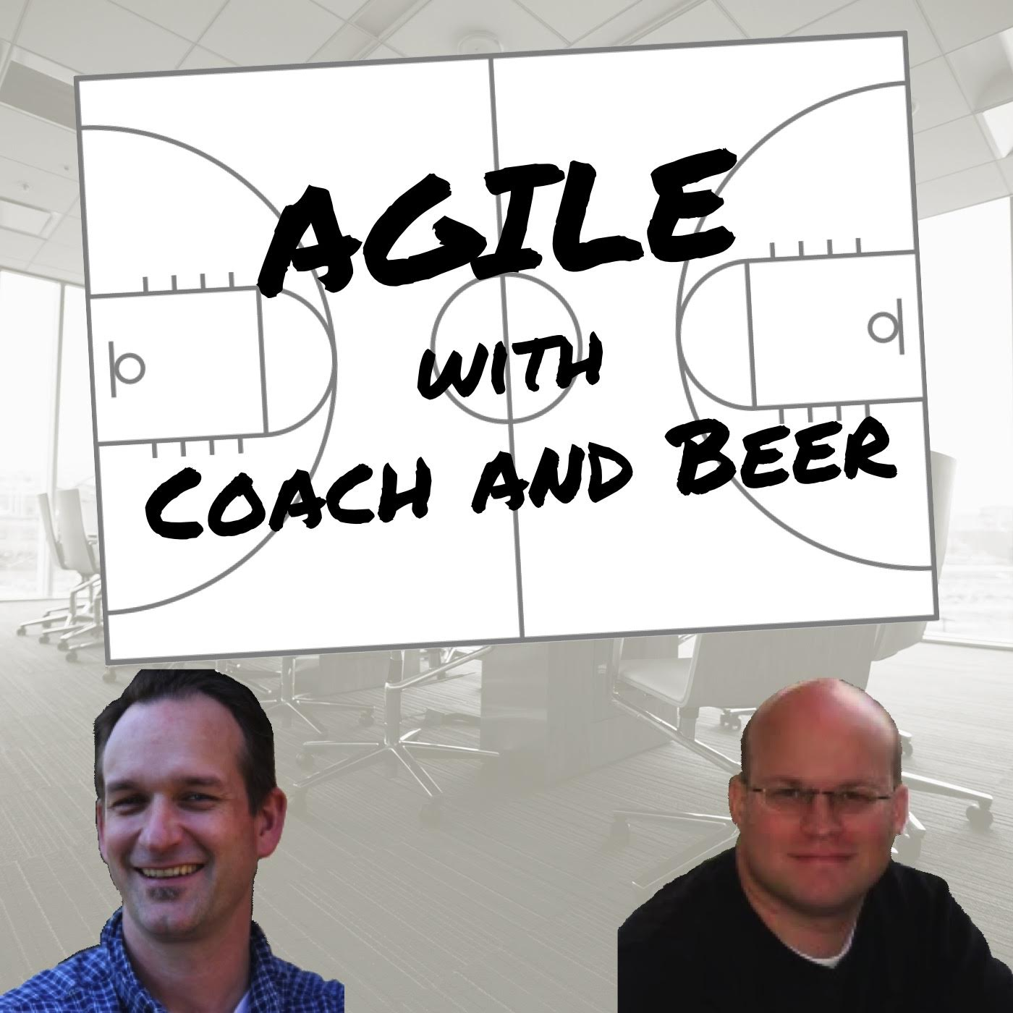
Check out my podcast!
Hosted by George Evjen and myself
Features:
Honest conversation about agile, delivery, and team leadership
Interviews with industry leaders
http://www.coachandbeer.com
iTunes/Google Play/Stitcher

Slide 17
Hastily thrown together slide on the spot!
http://www.polarissolutions.com/events

Slide 18

Join Polaris at Chicago Code Camp
We’ll be hosting a live podcast and delivering a number of talks!
Saturday, April 28th, 2016 at IIT – Chicago
Always FREE!
More info at: http://www.chicagocodecamp.com/

Slide 19


Join Polaris at ThatConference
Kalahari Resort, Wisconsin Dells, WI
August 7th - 9th, 2016
Early bird pricing ends May 1st
Web: http://thatconference.com/
Twitter: @ThatConference

