Slide 1
Agile Metrics that Matter
Prachi Maini
Manager, QA Engineering
Morningstar, Inc.

Slide 2
Executive Summary
The Concept
Define Metrics that can be used by Agile teams and Team management
The Opportunity
Reduced costs
The Potential
Auto Generate using exposed APIs provided by various tools
Increased team satisfaction

Slide 3
Independent investment research & management firm headquartered in Chicago.
Consumer report for securities.
Agile Squads (5-7dev, 1-2 QA, product owner, scrum master, designer).
Two week sprints.
Toolset
QAC for test case management
Selenium for functional automation
ReadyAPI for webservices
Webload for Performance

Slide 4
Why Do We Need Metrics
Drive strategy and direction.
Provide measurable data and trend to the project team and management.
Ensure that the project remains on track.
Quantify risk and process improvements.
Ensure customer satisfaction with the deployed product.
Assist with resource/budget estimation and forecasting.

Slide 5
Effective Metrics
Metrics should be clearly defined so the team or organization can benchmark its success.
Secure buy-in from management and employees.
Have clearly defined data and collection process.
Are measurable and shared.
Can be automatically generated and scheduled.

Slide 6
Agile QA Dashboard
Metrics are role agnostic.
Focus on trends rather than absolute values.
Used by teams to perform introspection on their own performance and feed into release planning
Core Agile metrics should not be used to compare different teams or focus on underperforming teams.
Notes:
Agile focuses on continuous improvement
Agile defines team members as anyone responsible for project execution and delivery which include developer, QA and documentation

Slide 7
Project Progress
Burndown Chart
Graphical representation of work remaining vs time.
Committed vs Completed
The percentage of points completed by the squad as a percentage of the committed points for the sprint
Tech Category
This helps identify how an agile team is spending its time. The possible values for tech category can be client customization, new product development, operations or maintenance.

Slide 8
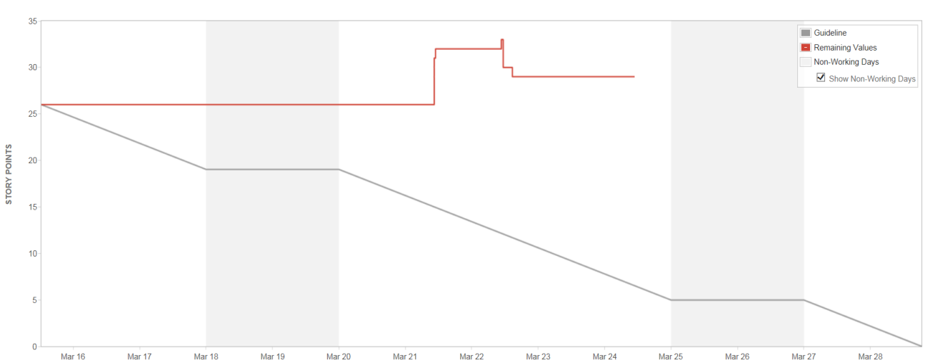
Committed vs Completed | Sprint 74 | Sprint 75 | Sprint 76 | Sprint 77 | Sprint 78
Committed | 148 | 105 | 98 | 53 | 154
Completed | 74 | 87 | 75 | 51 | 125
Tech Category | Sprint 74 | Sprint 75 | Sprint 76 | Sprint 77 | Sprint 78
Client Customization | 0 | 0 | 0 | 6 | 16
New Product Development | 157 | 171 | 91 | 144 | 109
Maintenance | 57 | 54 | 52 | 46 | 59
Other | 23 | 10 | 0 | 0 | 0

Slide 9
What To Watch For
The team finishes early sprint after sprint because they are not committing enough points
The team is not meeting its commitment because they are overcommitting each sprint.
Burndown is steep rather than gradual because work is not broken down into granular units.
Scope is often added or changed mid-sprint.

Slide 10
Velocity
Velocity
Points of work completed by an agile team within a given sprint
Adjusted Velocity
Points of work completed by an agile team accounting for holidays, team absence etc.
Calculated as velocity / available man days.
Running average of last three sprints is reported.

Slide 11
Capacity | Sprint 74 | Sprint 75 | Sprint 76 | Sprint 77 | Sprint 78
Team Size | 8 | 8 | 8 | 8 | 8
Available Days | 80 | 80 | 80 | 80 | 80
Unavailable Days | 10 | 12 | 11 | 5 | 0
Net Days (Capacity) | 70 | 68 | 69 | 75 | 80
Velocity
Total Points Completed | 73 | 87 | 75 | 51 | 125
Adjusted Velocity | 83 | 102 | 87 | 54 | 125
Avg Velocity (Last 3 Sprints) | 88 | 90 | 91 | 81 | 89

Slide 12
What To Watch For
An erratic average velocity over a period of time requires revisiting the team’s estimation practices.
Are there unforeseen challenges not accounted for when estimating the work
DO NOT
Use velocity to compare two different teams since the level of work estimation is different from team to team
Use velocity to identify lower performing teams.

Slide 13
Quality of Code
First Pass Rate
Used for measuring the amount of rework in the process
Defined as number of test cases passed on first execution.
FPR = Passed\Total on First Execution
For stories that deal with the development of new APIs or Features
For stories that deal with addendums to APIs or Features FPR should include regression.

Slide 14
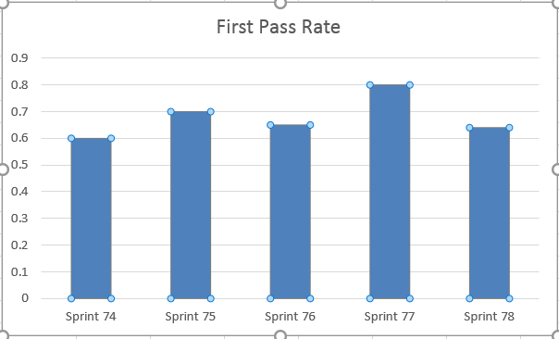
Story | Total TCs | Pass | Fail | FPR
Navy
PHX-10112 | 2 | 1 | 1 | 0.5
PHX-10411 | 8 | 6 | 2 | 0.75
PHX- 10382 | 15 | 8 | 7 | 0.8
PHX- 7703 | 10 | 6 | 4 | 6
PHX - 10336 | 1 | 1 | 0 | 1
 | 34 | 21 | 13 | 0.62

Slide 15
What To Watch For
Lower first pass rates indicate that Agile tools like desks checks , unit testing are not used sufficiently.
Lower first pass rate could indicate lack of understanding of requirements.
Higher first pass rate combined with high defect rate in production could indicate lack of proper QA.

Slide 16
Bug Dashboard
Net Open Bugs / Created vs Resolved
This gives a view of the team flow rate. Are we creating more technical debt and defects than what the team can resolve.
Functional Vs Regression Bugs Trend
This helps identify the defects found in new development vs regression.
Defects Detected in
This helps identify the environment in which the defect is detected. (QA, Staging, UAT, Production)
For defects detected in environment higher than QA, an RCA is needed.

Slide 17
Defects : Net Open Defects
 | Sprint 74 | Sprint 75 | Sprint 76 | Sprint 77 | Sprint 78
Bugs Opened | 68 | 36 | 33 | 41 | 17
Bugs Closed | 30 | 30 | 16 | 38 | 15
Net Open Bugs | 438 | 444 | 461 | 464 | 466
Defects : Regression vs Feature
 | Sprint 74 | Sprint 75 | Sprint 76 | Sprint 77 | Sprint 78
Regression | 16 | 24 | 16 | 38 | 40
Feature | 68 | 36 | 33 | 41 | 17

Slide 18
Defects Found By Environment
 | Sprint 74 | Sprint 75 | Sprint 76 | Sprint 77 | Sprint 78
QA | 25 | 30 | 28 | 30 | 32
Staging | 5 | 4 | 4 | 4 | 3
UAT | 1 | 3 | 1 | 3 | 1
Prod | 2 | 1 | 2 | 1 | 4
Defects : Root Cause (Non Production)
 | Sprint 74 | Sprint 75 | Sprint 76 | Sprint 77 | Sprint 78
Code | 15 | 21 | 21 | 22 | 19
Config | 5 | 4 | 4 | 6 | 3
Requirements | 1 | 3 | 1 | 3 | 1
Hardware | 2 | 1 | 2 | 1 | 8
Data | 2 | 9 | 7 | 4 | 5
Defects : Root Cause (Production)
 | Sprint 74 | Sprint 75 | Sprint 76 | Sprint 77 | Sprint 78
QA oversight | 15 | 21 | 21 | 22 | 19
Environment | 5 | 4 | 4 | 6 | 3
Requirements | 1 | 3 | 1 | 3 | 1
Existing Issue | 2 | 1 | 2 | 1 | 8
Data | 4 | 4 | 5 | 4 | 6

Slide 19
What To Watch For
An increase in regression bug count indicates the impact of code refactoring.
An increase bug count in non-QA environment due to environment differences requires revisiting the environment strategy.
An increase bug count in non-QA environment due to QA oversight requires revisiting the testing strategy.

Slide 20
Automation
Number of automated test cases
Percentage of automated test cases as part of total automation candidates
Percentage of automated test cases as part of total test cases
Can be reported separately for API , Functional , Migration testing
Defects Found by Automation
Number of defects found via automation and manual testing

Slide 21
Automation Progress
V2 Functional Test Cases | Sprint 74 | Sprint 75 | Sprint 76 | Sprint 77 | Sprint 78
# of Total Test Cases | 2444 | 2611 | 2684 | 2782 | 2822
# of Automatable Test Cases | 1541 | 1642 | 1690 | 1755 | 1774
# of Test Cases Automated | 1138 | 1234 | 1267 | 1339 | 1351
% Coverage of Automatable Test Cases | 73.85% | 75.15% | 74.97% | 76.30% | 76.16%
% Coverage of Total Test Cases | 47% | 47.26% | 47% | 48.13% | 48%

Slide 22
What to watch for
A decrease in automation coverage could indicate that a lot of automation capacity is being spent in script maintenance.
The coverage helps in identifying the percentage of application that can be effectively monitored and regressed on a recurring basis

Slide 23
Team Sentiments
Survey questions distributed to Agile Teams
Team members are anonymously asked to rate on a scale of 1 to 10 on questions pertinent to the project. Example of question include but are not limited to
Understanding of the vision of the project
Quality of the user stories
Collaboration between team members
Responses are tabulated and shared with the team
Trends are noted over time to identify teams alignment with the company and project vision and general satisfaction with the project and the company

Slide 24
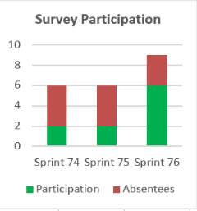
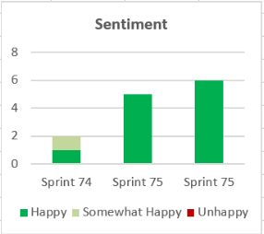
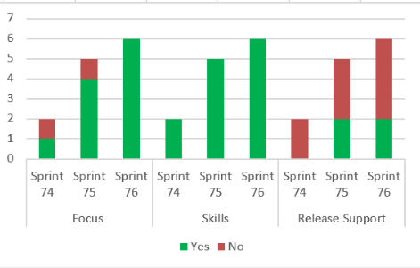
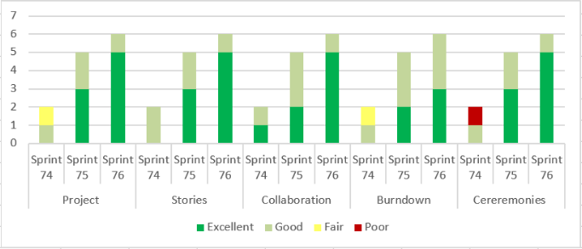

Slide 25
Thank You!!
Questions
Prachi Maini
prachi.maini@morningstar.com
pmaini@gmail.com
https://www.linkedin.com/in/prachimaini
Phone: 630-818-6472

