Slide 1
Data, Data Everywhere
david guimbellot

Slide 2

Test Data Management
You can’t test quality into a system by hiring a million testers
It’s not the quantitative testing but the qualitative

Slide 3
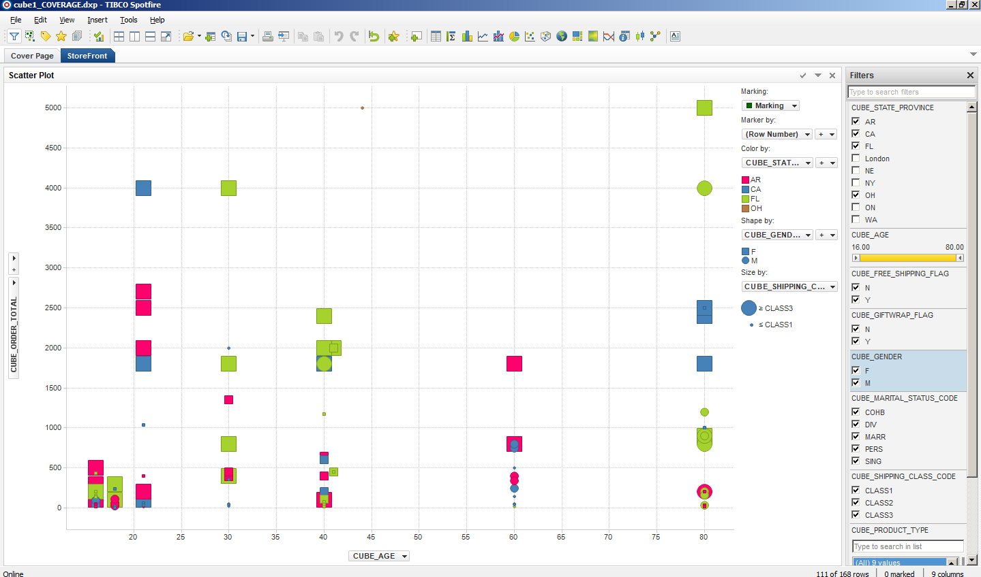
x-axis is the customer’s age
y-axis is the total the order
The Myth of Production Data

Slide 4
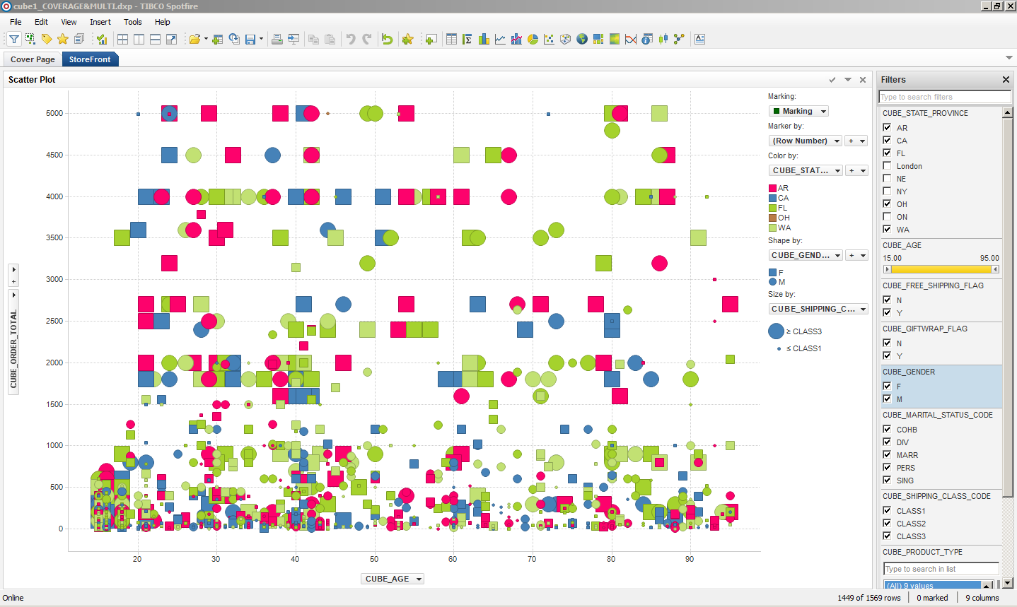
Minimum Data – Maximum Coverage

Slide 5



Automated Testing – Data Matching
SAP-1
DB-2
Automated Scripts
XML
Data Attribute Mining
Matched Test
Data Test Conditions
Test Matching

Slide 6
Covered Data in Development
Scenario Subset
Production Attributes
Covered Subset
Production & Enhanced Attributes
Generated Coverage
Notes:
Trainer to provide example of subsetting:
Huw’s Example:
“Now what most people do is type in the names of ten employees and I’m going to pull those ten employees. Same problem with test matching is that today, you might not have Anthea with holidays booked but an allocation and if I run a subset in a week’s time, she might have used up her allocation, so what you tend to do with subsetting is rely on lists of people – claims, policies, whatever – or even just the last three months; people who have had activity in the last three months, as the driving criteria you tend to lose granularity in subsetting so you end up with less interesting data than production so you’re in a worse case – you have less data, which is good and quicker but you may have lost some detail. So actually spending some time understanding the data in production and actually what we do is called a covered subset where what you’re trying to do is pull out ten or twenty of each TYPE of person. It’s much better way to go about it. We’re not going to cover that on the training course but it’s one of the key concepts. When it comes to doing your level 2 subsetting we will explain to you how to do this. For the time being, the subsetting we’re going to do, we’re just going to do the top one.”

Slide 7
Profiling
Discover your data
Use mathematical algorithms to sample data and understands the gaps in your coverage
Discover the exact data you need to satisfy your testing
Multi-dimensional cubed views allow you to understand how the data is related
Compare production and development data to indicate progress in creating data
Notes:
Trainer to provide simple example of profiling

Slide 8
Quality Pipeline

Slide 9
Production Data for Testing – The Gold Copy
Prod Copy
Mask
Subset
Gold Copy
Gold Copy
Test1
Dev1
Audit
Seed Data
Cross Ref
Test2
Dev2
Prod
Test + Development
Production

Slide 10
Test Integration

Slide 11
Augmenting Data for Coverage

Slide 12
Build server pipeline
Coverage pipeline

Slide 13
TDM Team – Specialization

Slide 14
TDM Role: Data Design

Slide 15
TDM Role in Support

Slide 16
TDM Role: Building Test Data

Slide 17
TDM Role: Execution

Slide 18
TDM Role: Audits

Slide 19
Filter View of Defects

