Slide 1
Mobile Device Quality Management
Barb Martens - QA Practice Director

Slide 2
Goals Today:
1
Recognize The Three Main Focus Groups
2
Adapt to Focus Group
Goals
3
Set Perimeters and Support
Boundaries
4
Select Tools that Fit Your Organization

Slide 3
Focus Groups
Identifying the development focus and business goals
Notes:
Steve

Slide 4
Goals Today:
1
Recognize The Three Main Focus Groups
2
Adapt to Focus Group
Goals
3
Set Perimeters and Support
Boundaries
4
Select Tools that Fit Your Organization

Slide 5


The Three Focus Groups
Corporations Building Applications For Their
Employees To Use In Day To Day Business Either
For Information, internal processes like benefits
or Workforce Automation
        Corporations Building Applications For Their Customers To Use In Doing Business With Them Retail Applications or Consumer to Business
Organizations Building Applications For The General Public Either As Free Ware Or For Sale
Product Development
Organizations Building Software For Any Of The Above Groups Fit In That Group For That Project Effort

Slide 6


Focus Group One
Work Force Optimization - Corporations Building Applications For Their Employees To Use In Day To Day Business
  Medical organizations capturing patient information at the patient side, in labs, or from outside
  sources and storing in a central
  repository for later use
            Claims Adjusters capturing information for claims adjusting or payment at the site of the incident
  Sales staff capturing orders at the customer site, insuring inventory and scheduling delivery, taking payments adjusting invoices

Slide 7
Focus Group Two
Corporations Building Applications For Their Customers To Use In Doing Business With Them
  Banks with mobile apps for checking
  balances, depositing checks,
  transferring funds
  Airlines for checking in to a flight, getting a bar code for scanning at the gate, checking arrival and departure times
  Retail organizations for taking order, checking inventory, shipping information, accepting payment, displaying statements

Slide 8

Focus Group Three
Organizations Building Applications For The General Public Either As Free Ware Or For Sale
  Displaying news such as Huffington Post, WSJ, Tribune
  Angry Birds Developers
  FaceBook

Slide 9
Goals Today:
1
Recognize The Three Main Focus Groups
2
Adapt to Focus Group
Goals
3
Set Perimeters and Support
Boundaries
4
Select Tools that Fit Your Organization

Slide 10

Differences Between Groups Are More Than Their Intended Audience
Group 1
  Focused on delivering data up and down the chain from the mobile device to a main computer and business applications
  Usually can control the devices it interacts with thru firewall and MDM strategies.
          Can ensure devices have controls, virus scanning and login credentials
          Can ensure their apps have completed basic editing and validation
          Can provide their own “app store” to ensure data has been processed in a specific way, i.e. use of MS Excel rather than a third party freeware program
          IS responsible for pushing new versions of software to the devices

Slide 11

Differences Between Groups Are More Than Their Intended Audience
  Is responsible for the security and protection of the network and its resources
          Must control access to the networks and applications
          Must provide support to the end user on the application, the device, the network and communications 24 x 7
          Can remove “unapproved” software and apps and disable features and functions of the hardware if there is a conflict
          Has the ability to scan devices and “wipe” data if device is lost, has not logged in with in a specific time period, or repeated login attempts failed.
  Is an extension of the Corporate IT Function

Slide 12
Differences Between Groups Are More Than Their Intended Audience
Group 2
  Focused on delivering select data up and down the chain from to the mobile device and to a specific user. Usually requires registration and passwords
  Can suggest types of devices and set recommended software/hardware requirements.
          Can NOT ensure devices have controls, virus scanning and login credentials
          Can NOT ensure other apps have completed basic editing and validation
          Can provide their own “app store” but can not control the use of other add-ons

Slide 13
Differences Between Groups Are More Than Their Intended Audience
Group 2
  Does Not have control of the device
    Can NOT remove “unapproved” software and apps NOR disable features and functions of the hardware.
    DOES NOT have the ability to scan devices and “wipe” data if device is lost, has not logged in with in a specific time period, or repeated login attempts failed.
  Cannot control what devices, versions of software or browsers are used to communicate
  Can not control communication networks (mobile carriers)
  Is NOT an extension of the Corporate IT Function

Slide 14

Differences Between Groups Are More Than Their Intended Audience
Group 3
  Focused on delivering an application and or data for use on the device
  Can suggest types of devices and set recommended software/hardware requirements.
          Can provide their own “app store” but can not control the use of other applications with conflicting add-ons
          Needs to keep current as new versions of browsers, devices and protocols come on line
          Needs to provide support and fixes as needed
          Needs to define the space they will support

Slide 15
Differences Between Groups Are More Than Their Intended Audience
Group 3
  Does NOT have control of the device
    Can NOT remove “unapproved” software and apps NOR disable features and functions of the hardware.
  Cannot Control what devices, versions of software or browsers are used
  Can not control communication networks (mobile carriers) if an interactive game
  Is NOT an extension of the Corporate IT Function
  Does not provide device support

Slide 16
Goals Today:
1
Recognize the three main Focus Groups
2
Adapt to Focus Group
Goals
3
Set Perimeters and Support
Boundaries
4
Select Tools that Fit Your Organization

Slide 17

Focus Group Impacts Scope and Breadth of Testing
Functional testing will need to be done for all groups
Repetition of the functional test will occur to monitor and document response and performance characteristics on a selection of devices, browsers and communication venues that comply with the corporate standard
Group One can de-scope non-corporate approved and supported devices but will need to extend the test to include the “mainframe” and upward communication and performance

Slide 18
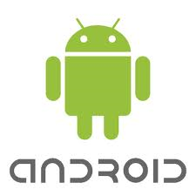

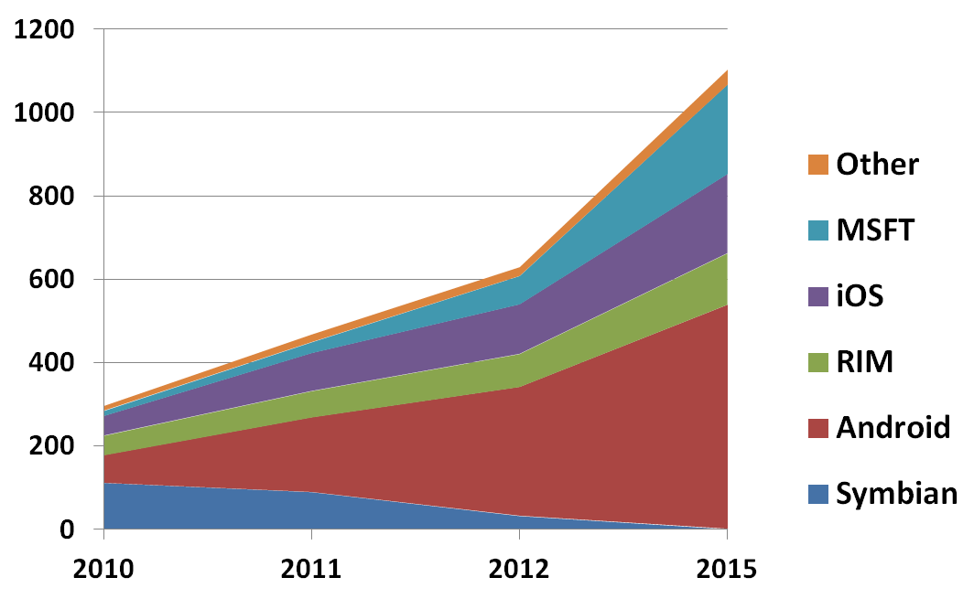
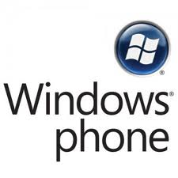

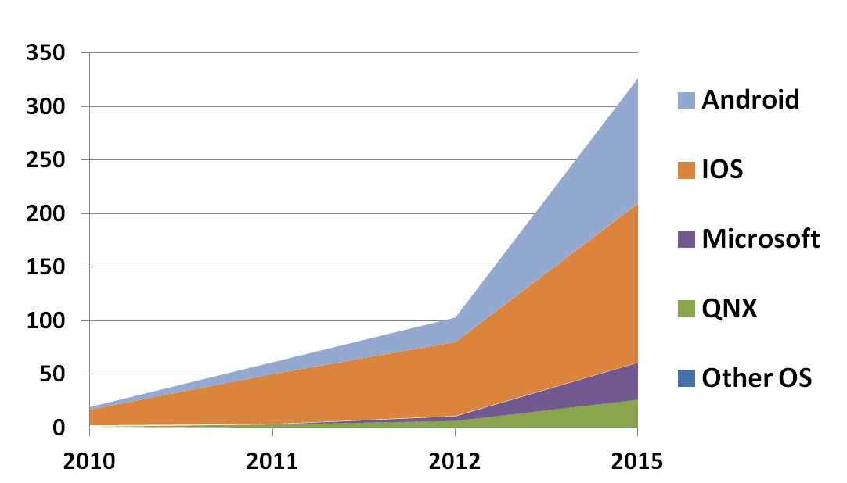
Which platform should we support?
Smartphones
'Must Do' Platforms
'Market Led'
Platforms
Source: Gartner
Tablets
'Must Do' Platform
'Market Led'
Platform
39
18
Source: Gartner

Slide 19

Focus Group Impacts Scope and Breadth of Testing
Group Two can focus on the supported or recommended devices and protocols, with the understanding you maybe eliminating a section of the customer base.
  Eliminating older browsers or devices may eliminate existing customers
  Will need to use some type of analytics to identify the devices and browser variations that are currently accessing your app and identify when you can de-scope.
  If apps are downloaded to the device
  directly and not thru and app store that
  tracks and notifies users when to upgrade
  you will need to create and test that feature
  You may also need to support older versions
  of you application

Slide 20
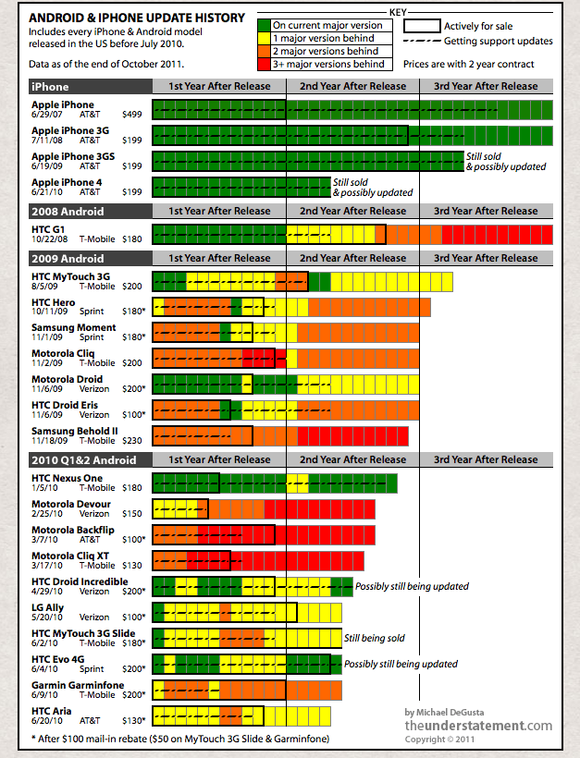

Android Fragmentation
Devices are not able to update to latest versions of android
Testing is complex
Some vendors may fork android
Device manufacturers apply unique "skins"
20

Slide 21

Focus Group Impacts Scope and Breadth of Testing
Group Three needs to determine their base platform and devices that they will support and focus on those combinations
  Additional browsers and devices widen the market place
  Limiting reduces the possible marketplace but the cost of support may outweigh the loss of sales or contacts
  Need to prepare to emulate devices that are not normally supported as you will get calls because of erratic behavior

Slide 22
Overall Market Trend
Mobile Web or Mobile App?
Customers will ask whether they should build a mobile web application (uses the device’s browser) or a native mobile app (needs to be downloaded from an App Store)
The next few slides outline the pros and cons of each approach
The key takeaway is that mobile apps become progressively more important as the customer transitions from a simple “Get in the Game” strategy to “Changing the Game”
  This can be an issue with Android. The lack of standardization on these devices, both at the hardware and operating system level, means that much more extensive testing is required to ensure that apps work on all major Android platforms and OS versions.
  This adds cost, complexity and risk; even more reason to
  have a clearly defined, well-articulated mobility strategy
40
22

Slide 23
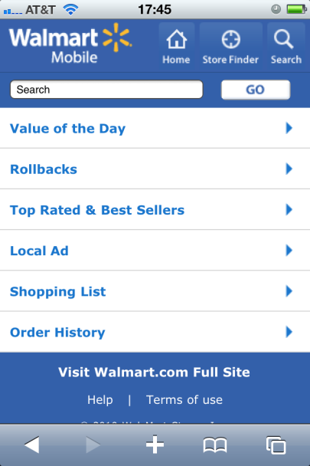
What Are The Pros & Cons Of A Mobile Website?
Pros
  Latest browsers increasingly support
    access to local resources
    latest performance optimization approaches
  Short time to market
  Higher level of device compatibility
Cons
  No access to certain native resources – e.g. camera
  Sophisticated performance optimization techniques difficult to master
23

Slide 24
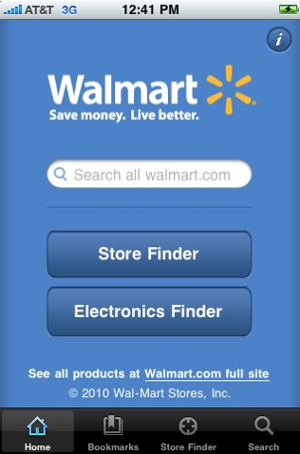
What Are The Pros And Cons Of A Mobile Application?
Pros
  Device-specific look and feel
  Access to local/native resources
  One touch startup
  Opportunities for improved perceived performance
Cons
  Friction (App stores)
  Need to maintain backwards compatibility/fragmentation
  Long time to launch/approval process
24

Slide 25
Functional Testing and Automation
Without a doubt replaying functioning code on various devices and software combinations is the most time consuming phase of mobile testing for Groups Two and Three
Simulators and Emulators can be used to automate a great portion of this activity
What is the difference between an Emulator and a Simulator?

Slide 26
Simulator and Emulator
A simulator is a partial implementation of a device/platform, it does just enough for its own purposes.
A simulator is a software or hardware system that mimics another complicated system, with a varying level of reality
An Emulator is limited to imitating computer hardware systems. In short, emulators are computer system simulators. For example, there are emulators for just about every kind of phone that runs on desktop computers. These emulators allow programmers to write software for the emulated system without needing the hardware in hand.

Slide 27
Emulator
Emulated devices are easier to manage.
You can switch device types by simply loading a new device profile.
Emulators run on more powerful PCs and servers and were designed with testing in mind,
They are typically fully instrumented to capture detailed diagnostics about the protocols that go back and forth between client and server at the various levels of the stack.
When you encounter an application fault, you will have the information to isolate and thus correct the problem.
Emulated devices are thus cost effective, because a single platform with frequent updates of device profiles can be used to test every device on the market both today and tomorrow.
The big disadvantage of emulated devices is that they lack the quirks and faults that only the real device can provide.

Slide 28
Goals Today:
1
Recognize the three main Focus Groups
2
Adapt to Focus Group
Goals
3
Set Perimeters and Support
Boundaries
4
Select Tools that Fit Your Organization

Slide 29
Android Emulator
For those of you who want to test drive Android you can use this Android Emulator which is patched to run on a Windows PC as a standalone app without having to download and install the complete and complex Android SDK, and you can even install and test Android compatible apps on it.
Google Android Emulator
http://cloud.addictivetips.com/wp-content/uploads/2009/Android-Emulator.zip
Official Android SDK Emulator
The Android SDK includes a mobile device emulator which mimics all of the hardware and software features of a typical mobile device (although, without the calls). It provides a variety of navigation and control keys, which you can "press" using your mouse or keyboard to generate events for your application. It also provides a screen in which your application is displayed, together with any other Android applications running.

Slide 30
Multiple Platform
MobiOne
MobiOne Developer is a mobile Web IDE for Windows that helps developers to code, test, debug, package and deploy mobile Web applications to devices such as iPhone, Blackberry, Android, and the Palm Pre.
Recently updated with its seventh version, it now includes a new drag-n-drop mobile Web visual designer for mockups, mobile HTML code generation, convenient mobile design templates, updated OSS components, screen capture, multi-touch and gesture support.
MobiOne Homepage & Downloads » http://m.genuitec.com/mobione_mobile.html

Slide 31
iPhone
TestiPhone.com – iPhone Application Web Based Simulator
TestiPhone is a web browser based simulator for quickly testing your iPhone web applications. This tool has been tested and works using Internet Explorer 7, Firefox 2 and Safari 3.
TestiPhone.com – iPhone Application Web Based Simulator » http://testiphone.com/ http://testiphone5.com/
iPhoney
iPhoney gives you a pixel-accurate web browsing environment – powered by Safari – that you can use when developing web sites for the iPhone. It's the perfect 320 by 480-pixel canvas for your iPhone development.
iPhoney is not an iPhone simulator but instead is designed for web developers who want to create 320 by 480 (or 480 by 320) websites for use with iPhone. It gives you a canvas on which to test the visual quality of your designs. Runs on MAC
http://sourceforge.net/projects/iphonesimulator/

Slide 32
Palm
Emulator – Palm Developer Center
This official Palm emulator emulates the Palm WebOS device on a Linux, Mac and or Windows. If you already the SDK installed, you will already have the emulator on your computer.
Pre Emulator – Palm Developer Center »
Download the Palm Pre SDK (Mac, Linux and Windows) »

Slide 33
Nokia
Nokia Platform and Device SDKs
When coupled with your favorite development tool, the S60 platform and device SDKs provide all the features required to quickly and efficiently build and test Symbian applications on a PC.
Nokia Platform and Device SDKs »
Nokia Device Specifications »
Nokia Mobile Browser Simulator 4.0 »
NMB 4.0 is a mobile Internet browser SDK that can browse mobile Internet content from your local computer. This resource has been archived because it is not considered relevant for developers creating commercial solutions today, but it was still fun playing about with it.

Slide 34
Blackberry
iBBDemo – Blackbaud iPhone Browser Simulator
iBBDemo correctly renders Webkit targeted html including the custom -webkit CSS extensions, effectively giving you a compelling demo/test platform for iPhone Web content from the comfort of a Windows desktop (who said it could not be done?).
iBBDemo – Blackbaud iPhone Browser Simulator »
iPhone Browser Simulator for Windows Screencast »
BlackBerry Simulator
There are a variety of official BlackBerry simulators available to emulate the functionality of actual BlackBerry products. With any of the BlackBerry device simulators, you can demonstrate and test how the BlackBerry device software, screen, keyboard and trackwheel will work with your application. These simulators will also simulate behavior in various wireless network conditions.
BlackBerry Simulator »
Software Downloads for Blackberry Device Simulators »

Slide 35
Scripting Tools
TestFlight: TestFlight is an open source tool that makes testing on iOS platforms easy by automating the distribution of the app and provisioning files easy.
You don’t need to maintain distribution mailing lists once you get the UDID of an iOS device and authorize that device for running a test version of your apps.
Beyond that, TestFlight enables setting checkpoints in your app, asking questions of testers and collecting answers at those checkpoints, providing detailed test session logs, keeping track of app crashes, and also keeping track of which parts of the app are popular with users.

Slide 36
Scripting Tools
SeeTestMobile: SeeTestMobile by Experitest is an automated scripting tool.
You attach a smartphone using a USB cable to a laptop or a desktop running SeeTestMobile.
You start the recording, use an app and then stop the recording. This automatically records a test script that can be run again, when a new release is available.
The test script is run automatically on both the attached mobile device as well as on the simulator.
Results are recorded in the SeeTest environment for analysis.
The automated script can be converted and integrated with multiple other existing target test environments like QTP, TestComplete, MSTest, Junit, PERL and Python.

Slide 37
Scripting Tools
RealMobile: RealMobile from Conflair builds a wrapper around common test automation tools like QTP and Quality Center and builds a custom environment for mobile testing.
Since existing environments are used for mobile testing, integrating it with testing of other applications within the organization is easier.
RealMobile provides testing on mobiles as well as simulators. Mobiles can communicate with the laptop or desktop using USB or wireless connections.

Slide 38
Scripting Tools
TestCountdown: TestCountdown from BSQUARE is a modular test environment with separate design and execution environments.
This enables the geographic separation of the test design and test execution activities.
Test execution can also be done from multiple execution instances, and so multiple, distributed testing efforts are facilitated.

Slide 39
Scripting Tools
FoneMonkey: FoneMonkey by Gorilla Logic is a free, open source tool that comes in separate versions for iOS and Android.
The tool records a test execution as a script and can run it again in an automated way.
Scripts from the iOS version can be exported into an OCUnit Test scripts for use with Objective-C,
Those from the Android version can be converted into JUnit ones.

Slide 40
Scripting Tools
Zap-Fix: Zap-Fix for Mobile generates scripts from recordings of manual tests and can be run again manually or in an automated way.
It is integrated with HP QTP
It supports WebOS from HP in addition to iOS, Android, Blackberry and Microsoft Windows Mobile.

Slide 41
Scripting Tools
DeviceAnywhere: DeviceAnywhere for Mobile from Keynote Systems integrates with HP and IBM test environments.
They also provide testing services from multiple locations across the globe for mobile apps that access backend servers for execution.
This is to ensure that response times from the app are reasonable no matter where they are used in the world.

Slide 42
Performance
Gomez Mobile Website Performance Test
  End-users’ expectations for mobile website performance keep rising. In a 2011 survey of 4,014 mobile web users 74% were only willing to wait 5 seconds or less for a single web page to load on their phone before leaving the site.
  With mobile sites your customers expect transactions that are fast and work flawlessly. Failure to deliver quality web experiences through slow or malfunctioning mobile sites will result in lost customers and business.
Are you meeting your customers’ mobile website performance expectations? Take the Gomez Mobile Website Performance Test and find out.

Slide 43
Performance
Gomez Cross-Device Website Compatibility Test
  Your customers are visiting your Web and mobile sites on devices ranging from Apple’s iPhone to RIM’s BlackBerry.
  Do your Web and mobile sites work properly across all these devices?
  Find out with Gomez’s Cross-Device Website Compatibility Test and:
    Identify browser problems that impact your end-users
    Ensure device compatibility issues do not result in lost revenue and brand equity
    See how your website renders across four real mobile devices
      iPhone 3GS
      iPad
      BlackBerry Storm 2
      Nexus One (Android)

Slide 44

Selecting a Partner
Enterprise
and Cloud Integration
Strategy
Design, Development, Delivery
Quality Assurance
Performance
Security
Machine to Machine - M2M
44

Slide 45
Questions

